Slide 1

RNASeq Downstream Analysis
Nidhi Mahejabeen Hossain

Slide 2
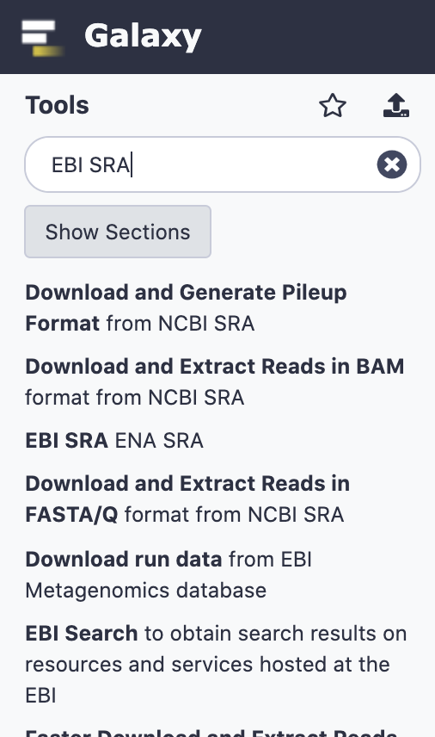
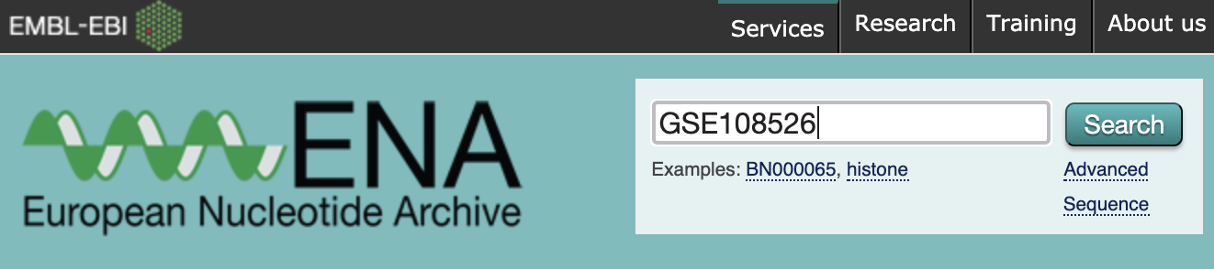
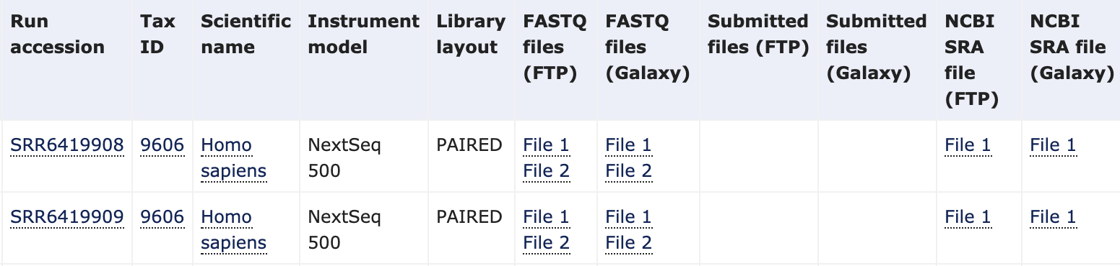
Importing Sample Data (NCBI GEO)
EBI SRA tool on Galaxy
Search using GEO accession
For paired library, both files need to be uploaded.
File 1 and 2 are forward and reverse read respectively
Choose FASTQ files
SRA files need to be converted to FASTQ and separated into forward and reverse

Slide 3
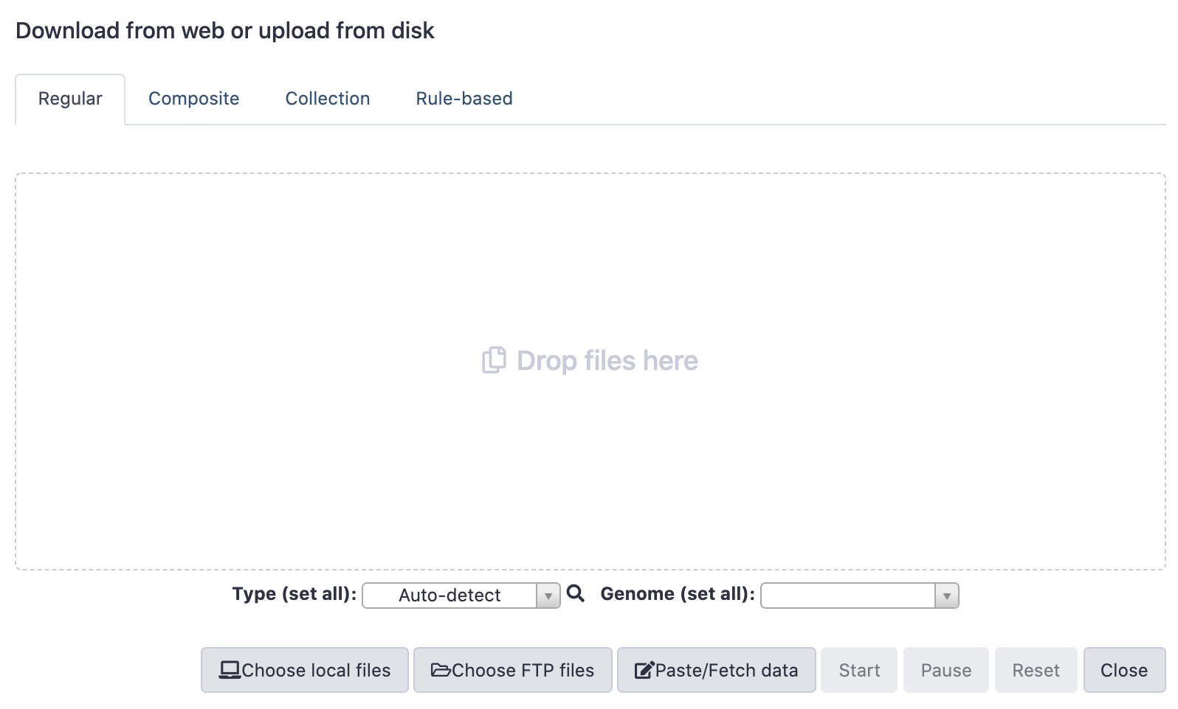
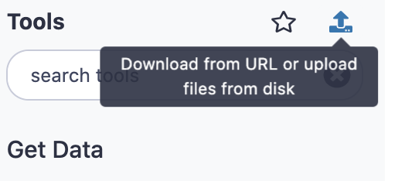
Importing Sample Data (Unpublished Study)
For in house samples, import from local files.
For pair ended library, two files (forward and reserve complement) need to be uploaded for each sample

Slide 4
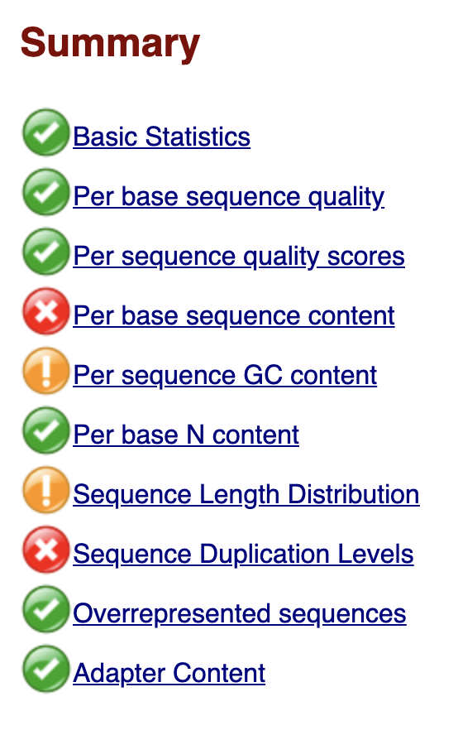
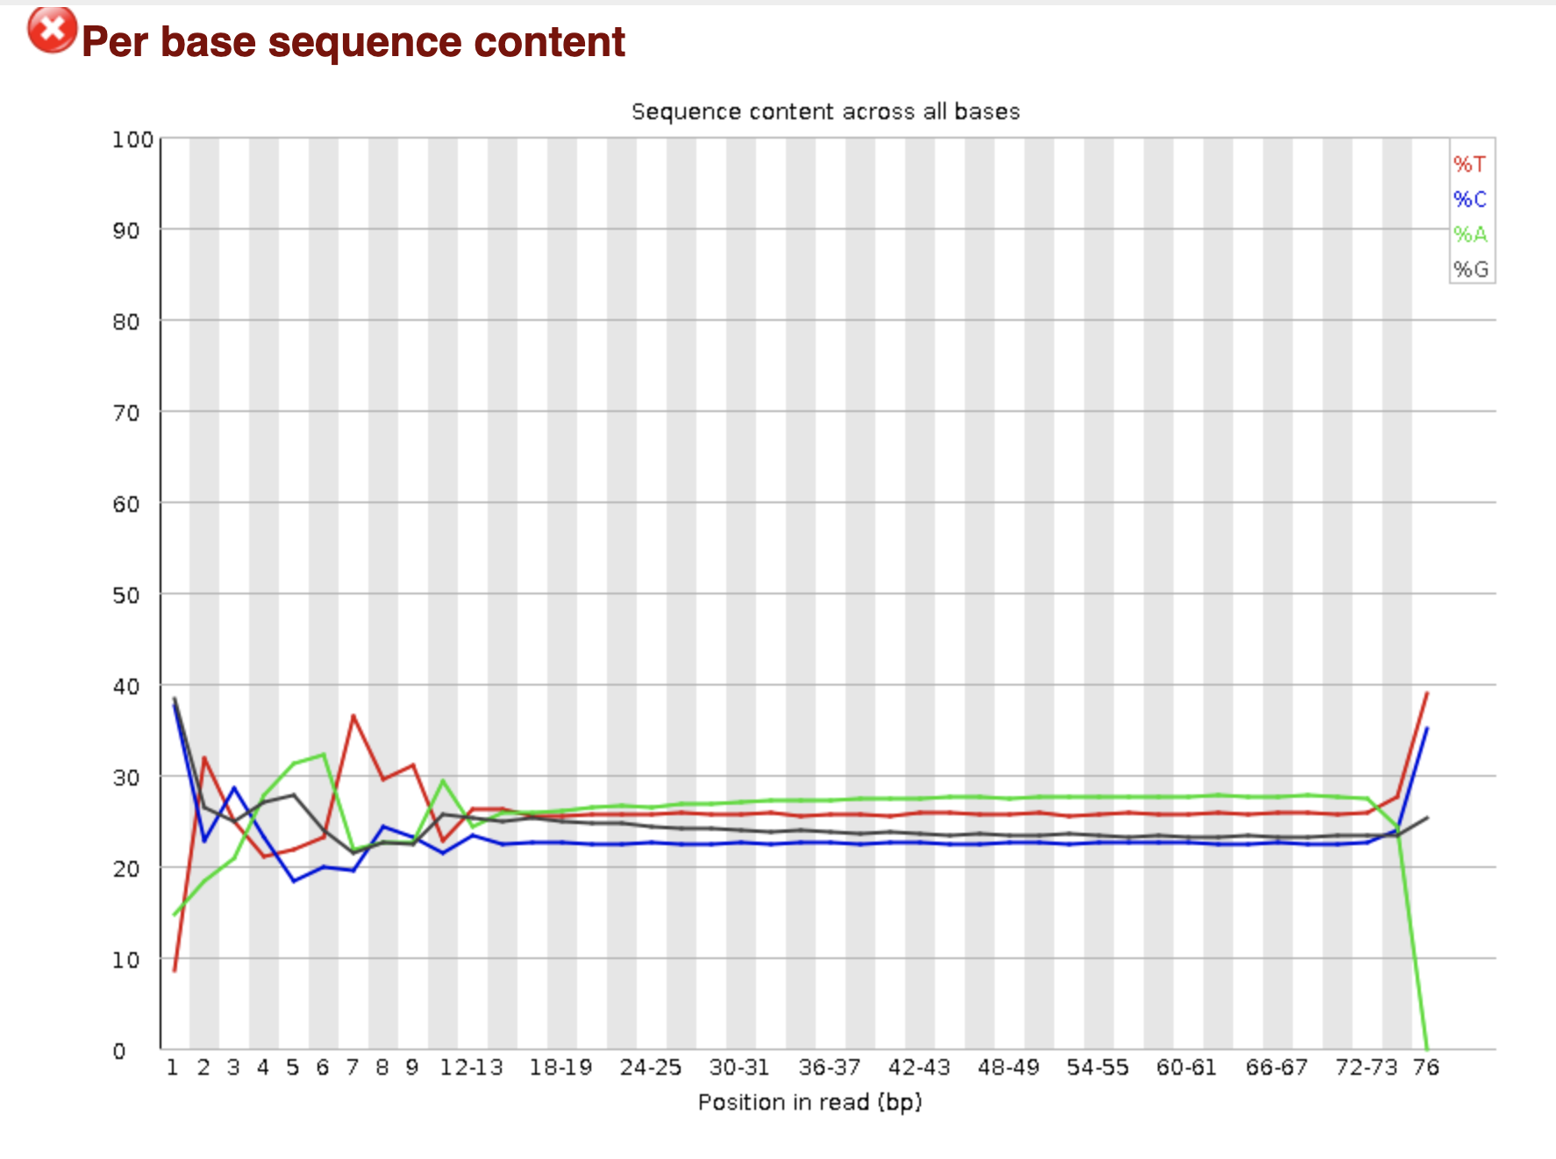
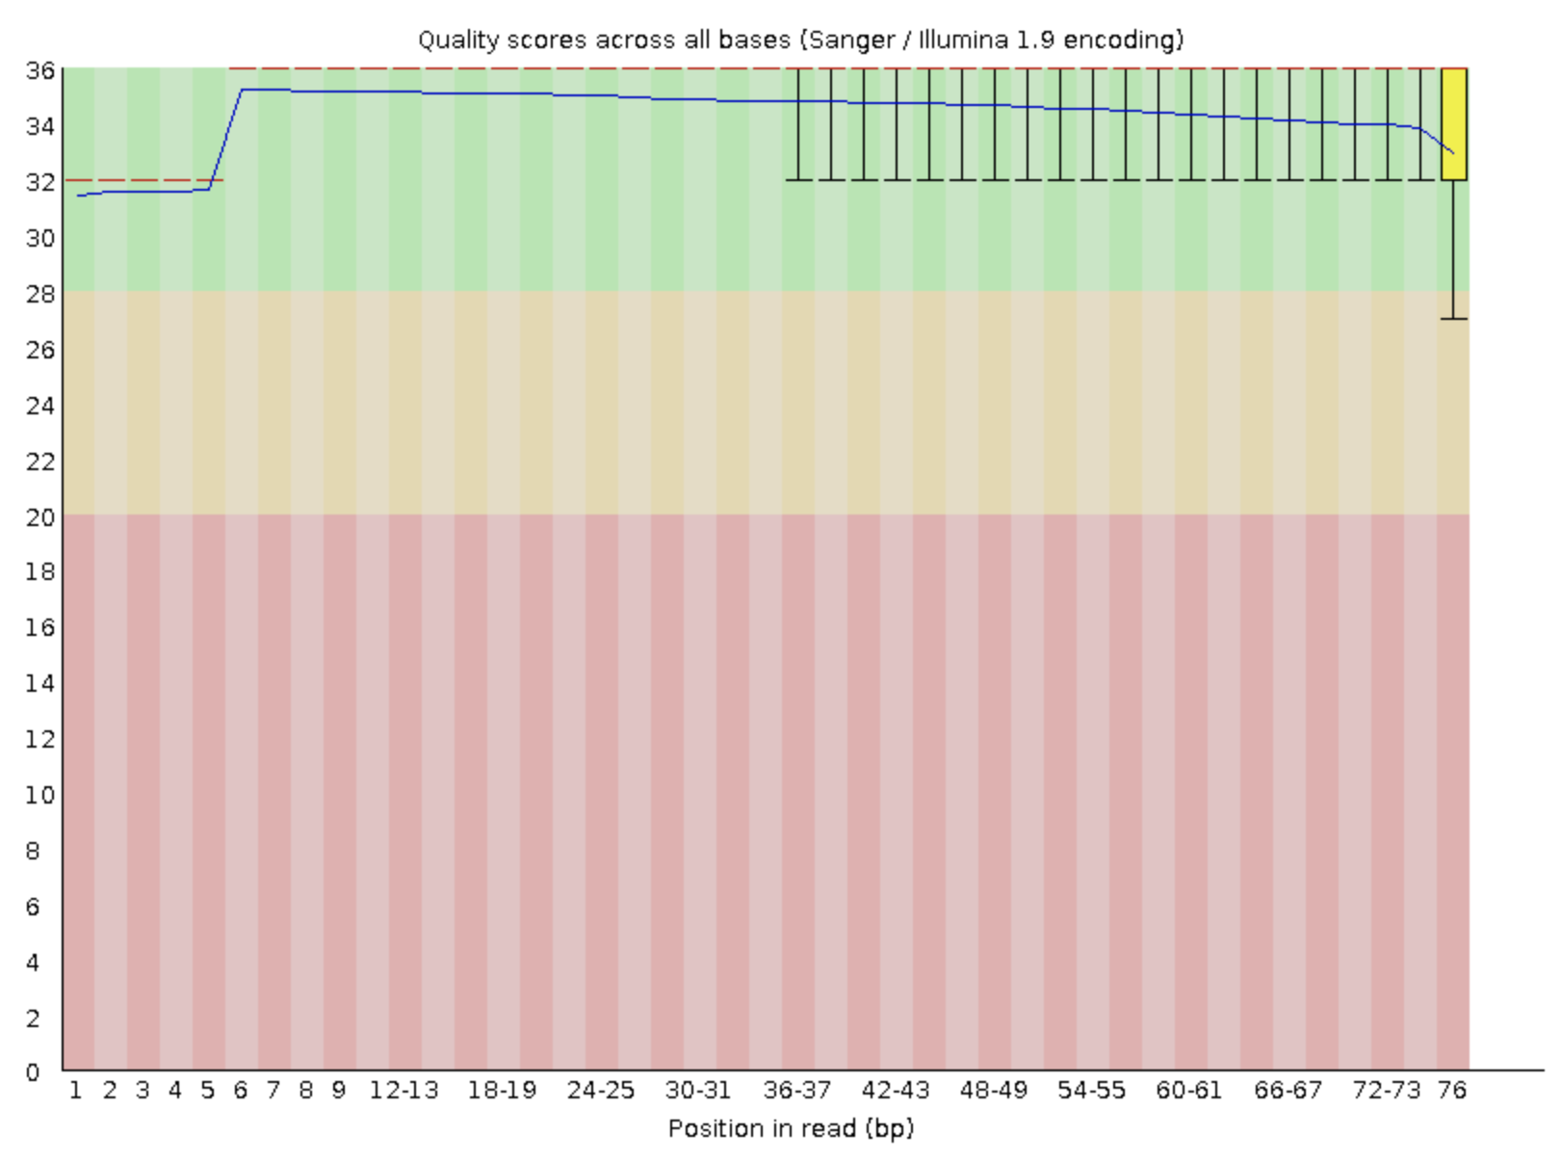
FastQC
Quality check
Indicates segments for trimming

Slide 5
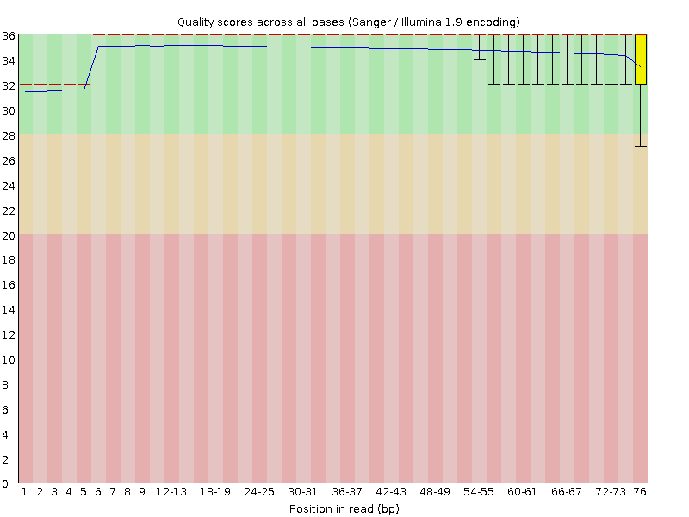
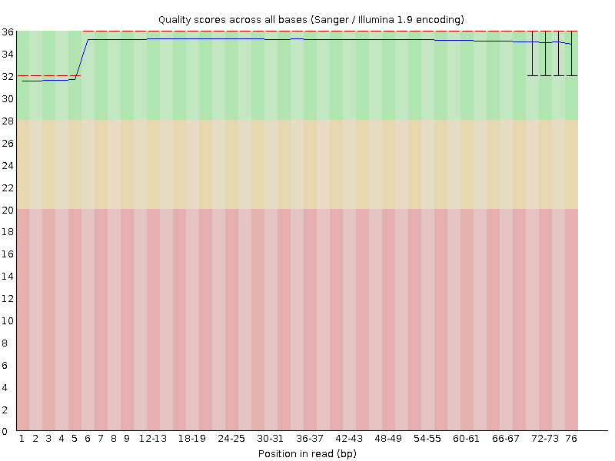
FastQC before and after Trimmomatic
Before
After

Slide 6
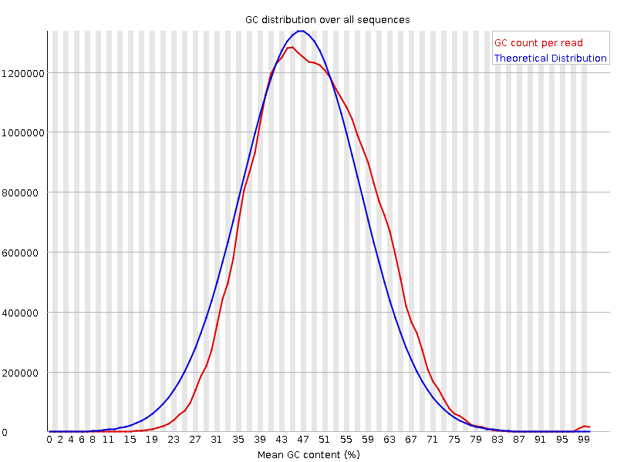
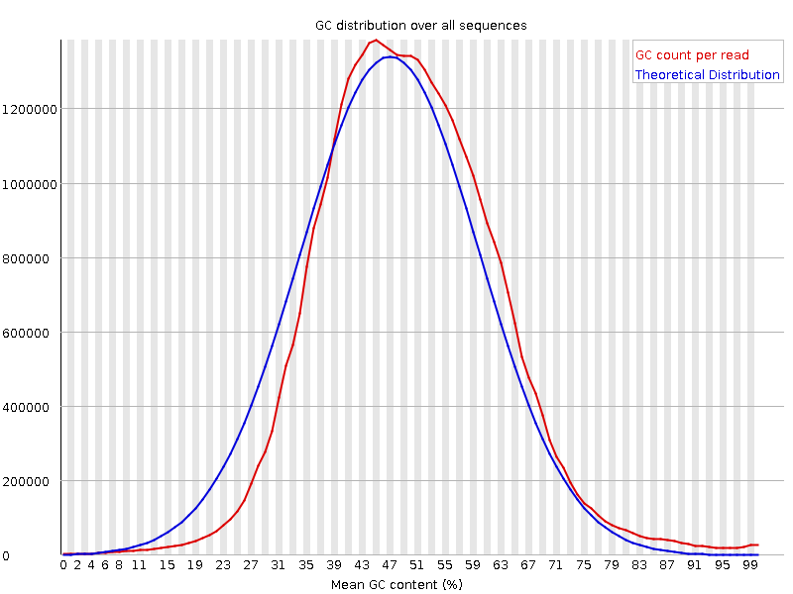
Slight changes but still flagged yellow
Before
After

Slide 7
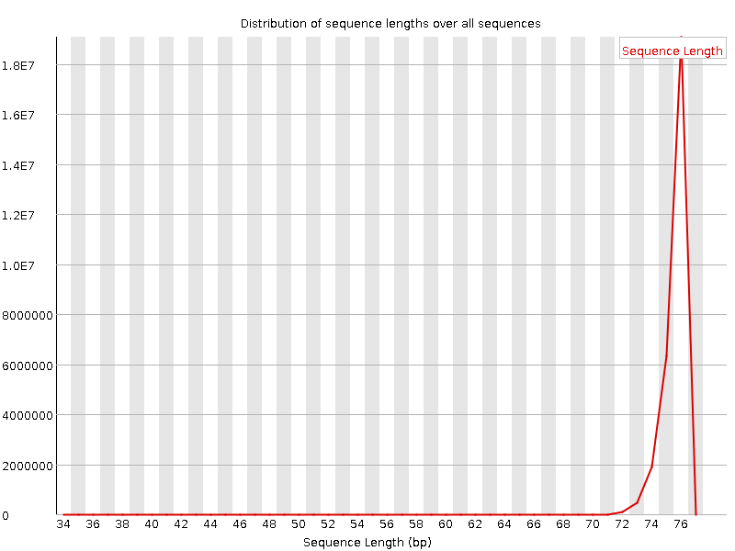
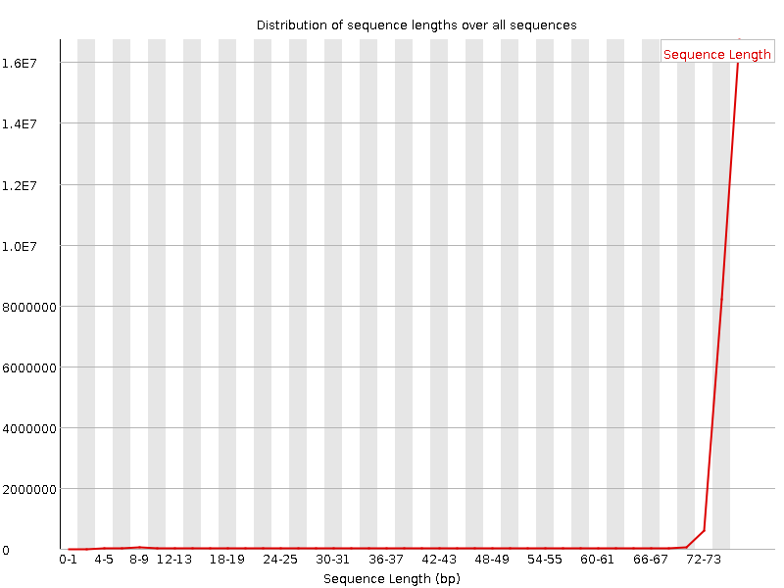
Slight changes but still flagged yellow
Before
After

Slide 8
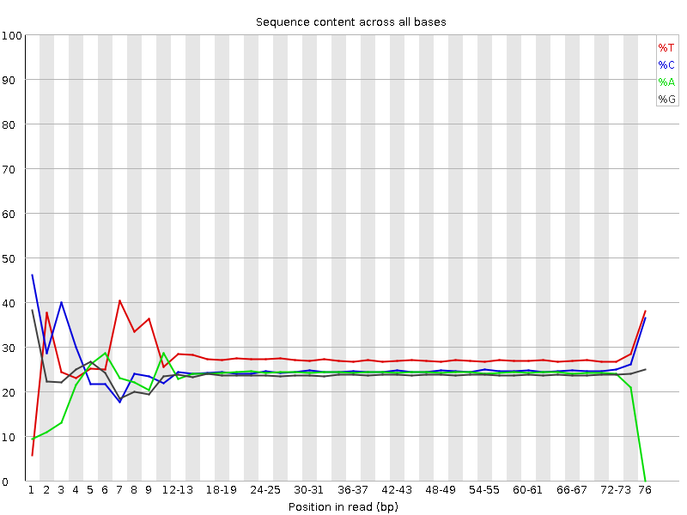

Red Flagged Qualities not fixed with trimming
Before
After
Considering trimming the ends instead of using sliding window trimming

Slide 9
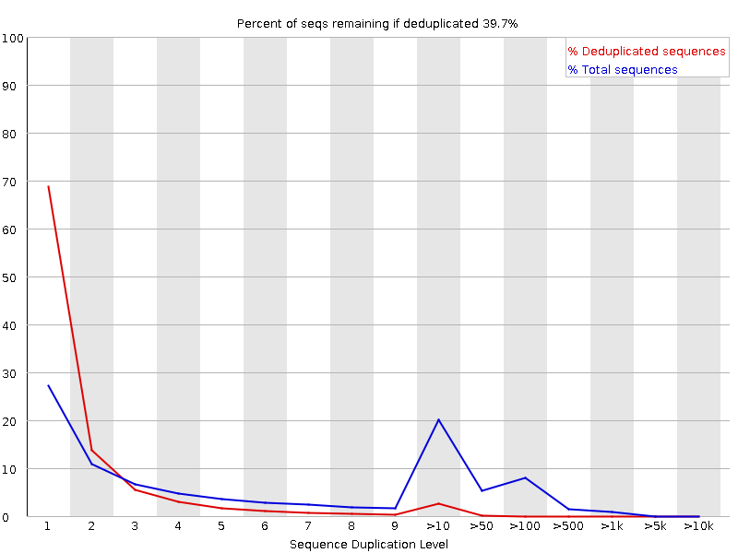
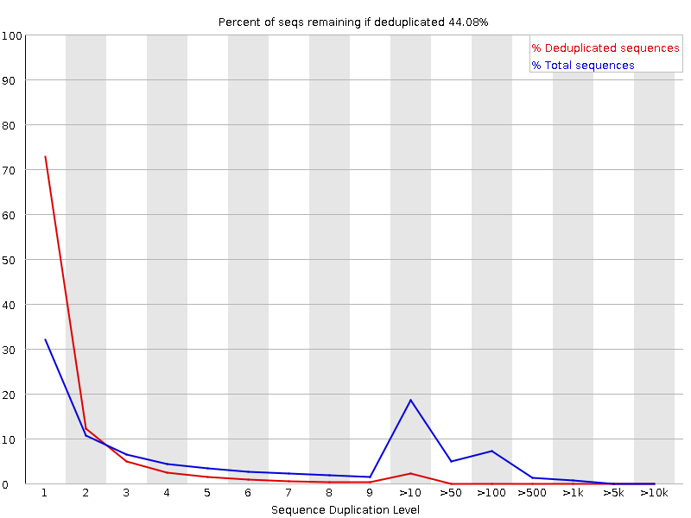
Red Flagged Qualities not fixed with trimming
Before
After

Slide 10
HISAT2
HISAT2 used for initial alignment as RNA STAR was not running temporarily on Galaxy
RNA STAR is the preferred tool for alignment
Uncompressed fasta file of the genome sequence
https://www.gencodegenes.org/human/
Import to Galaxy

Slide 11
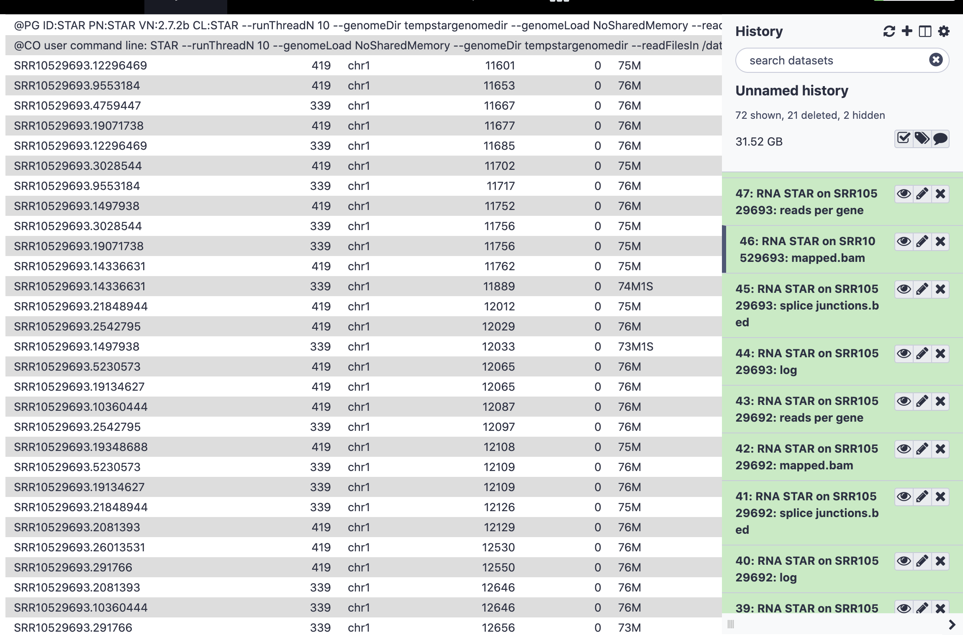
RNA STAR
Only works on https://usegalaxy.eu/

Slide 12
HTSeq
Gene annotation (GTF file) of the same version as fasta file from GENCODE
Outputs:
first column ENSEMBL gene ID
Second column counts

Slide 13
DESeq2 on Galaxy
Input HTSeq count according to the factors and subfactors.
Outputs:
Results file with baseMean, Log2FC, adj.pvalue, etc
Visualization in pdf file
Normalized Counts

Slide 14
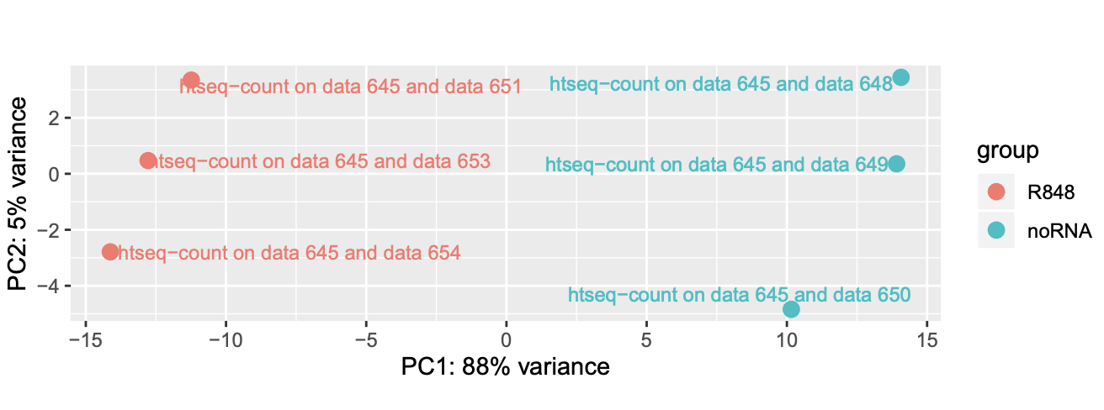
PCA

Slide 15
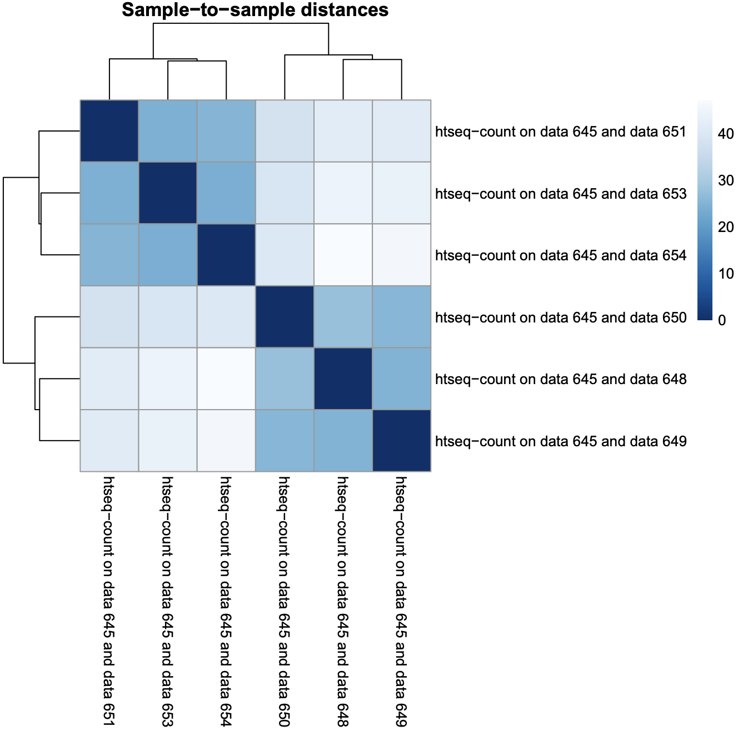
Sample to Sample Distance

Slide 16
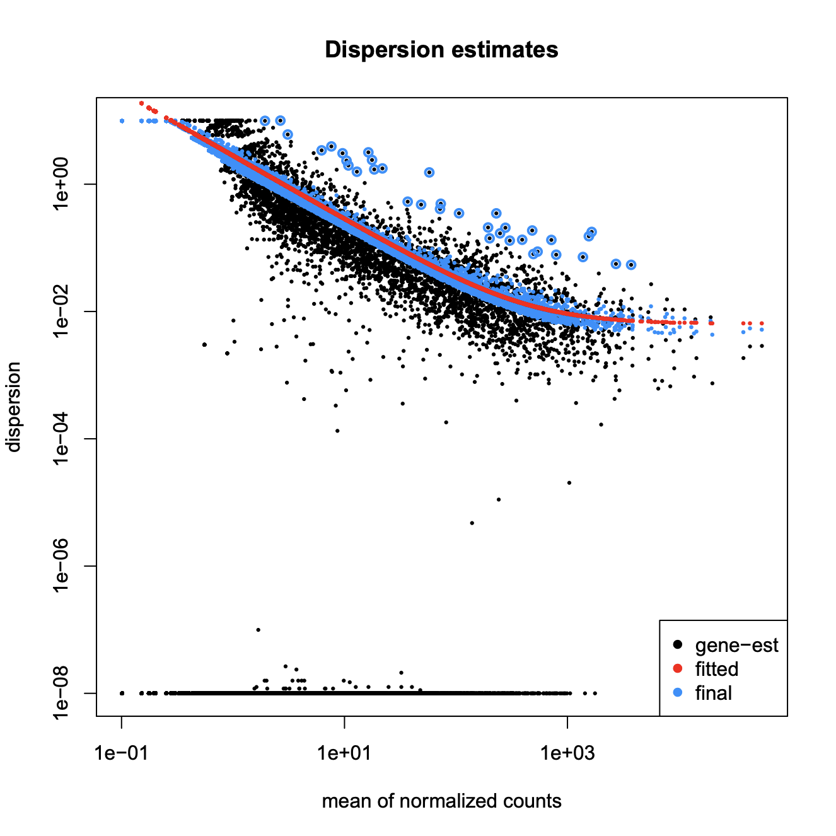
Dispersion Estimates

Slide 17
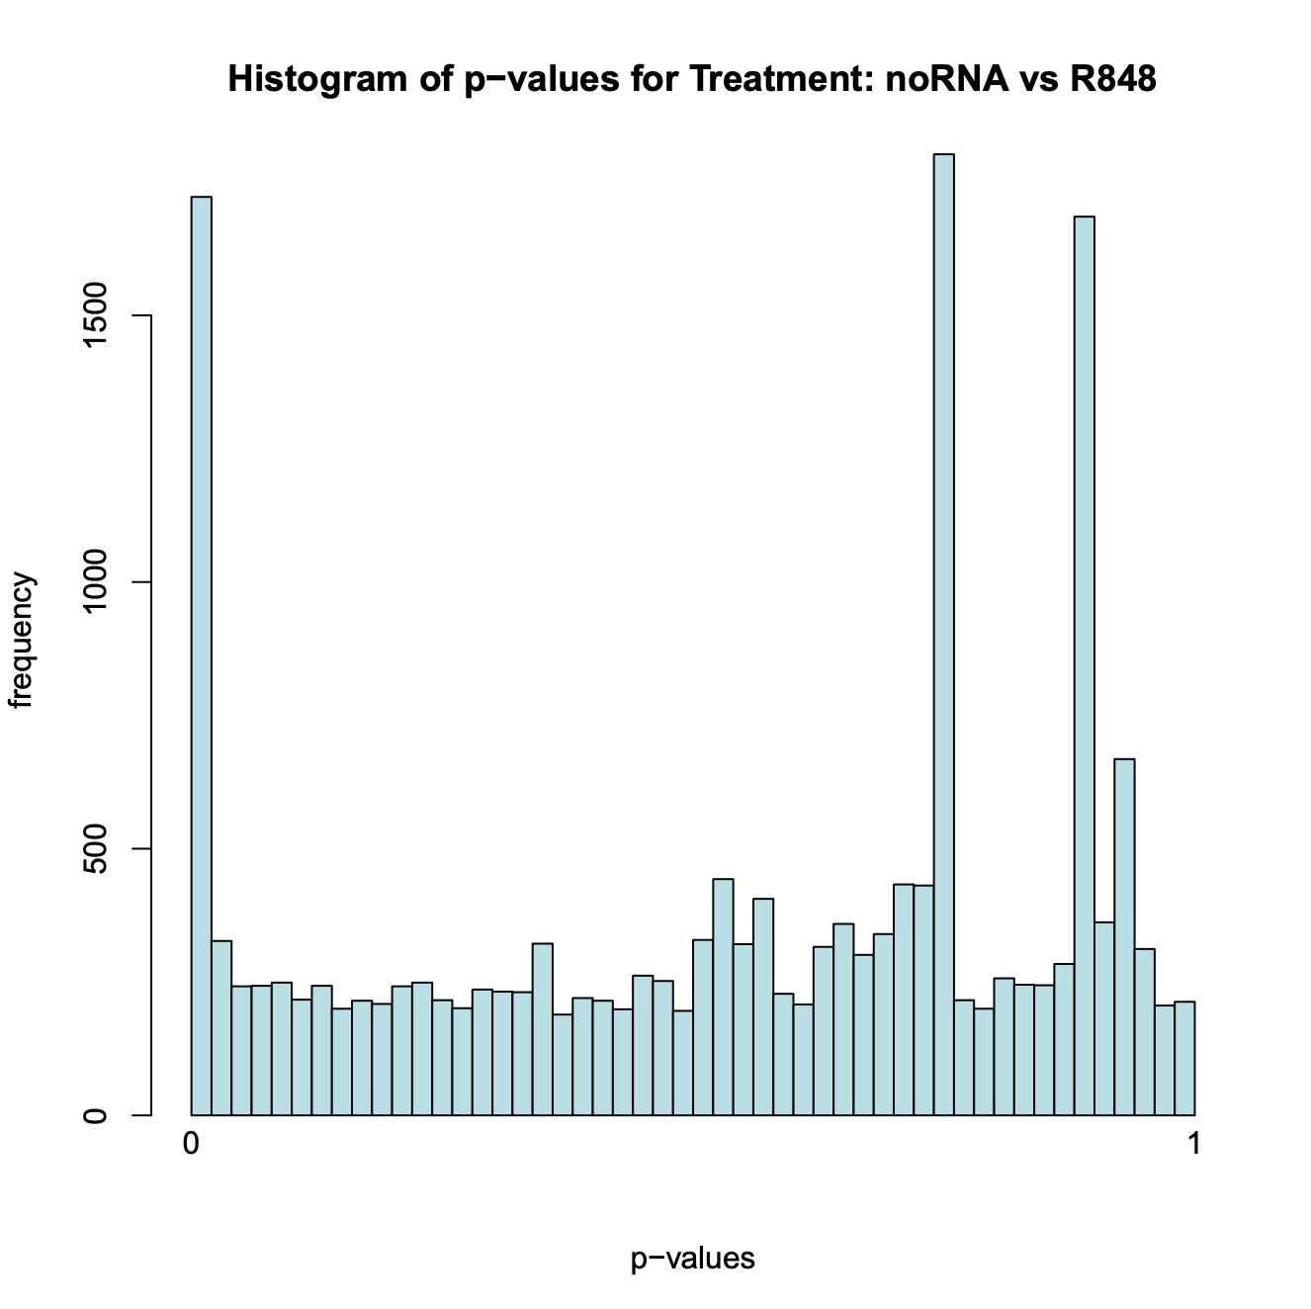
Histogram of p-values for Treatment

Slide 18
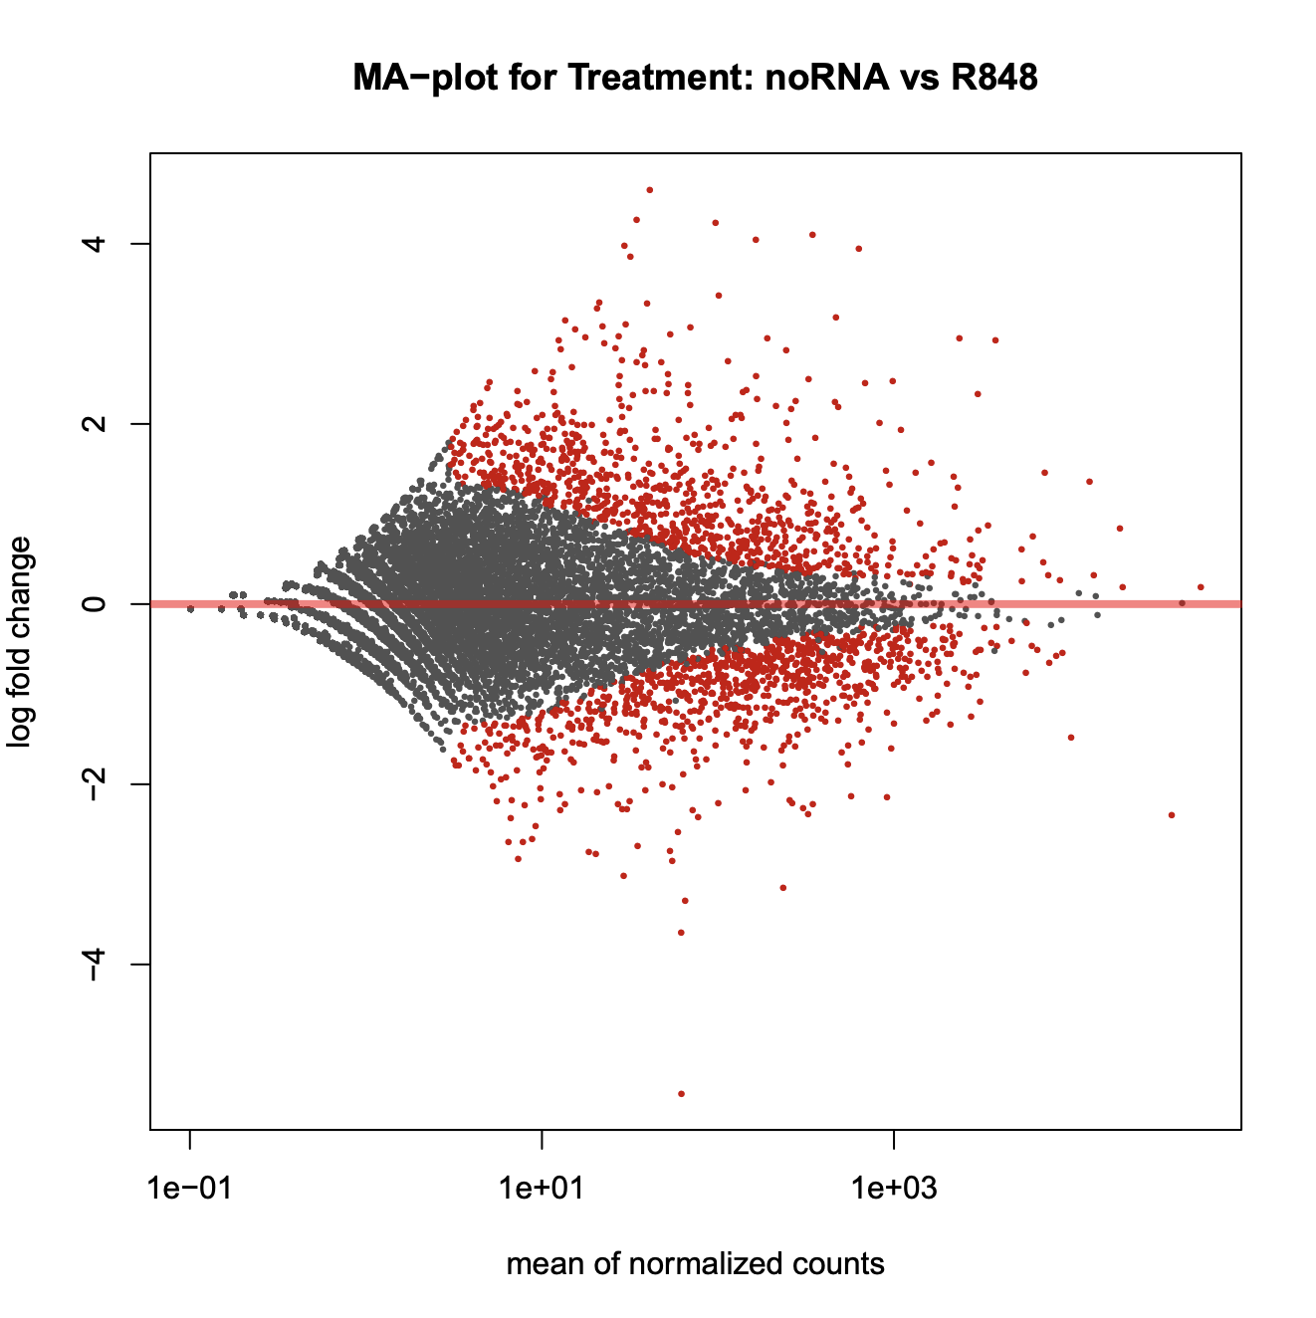
MA-plot for treatment

Slide 19
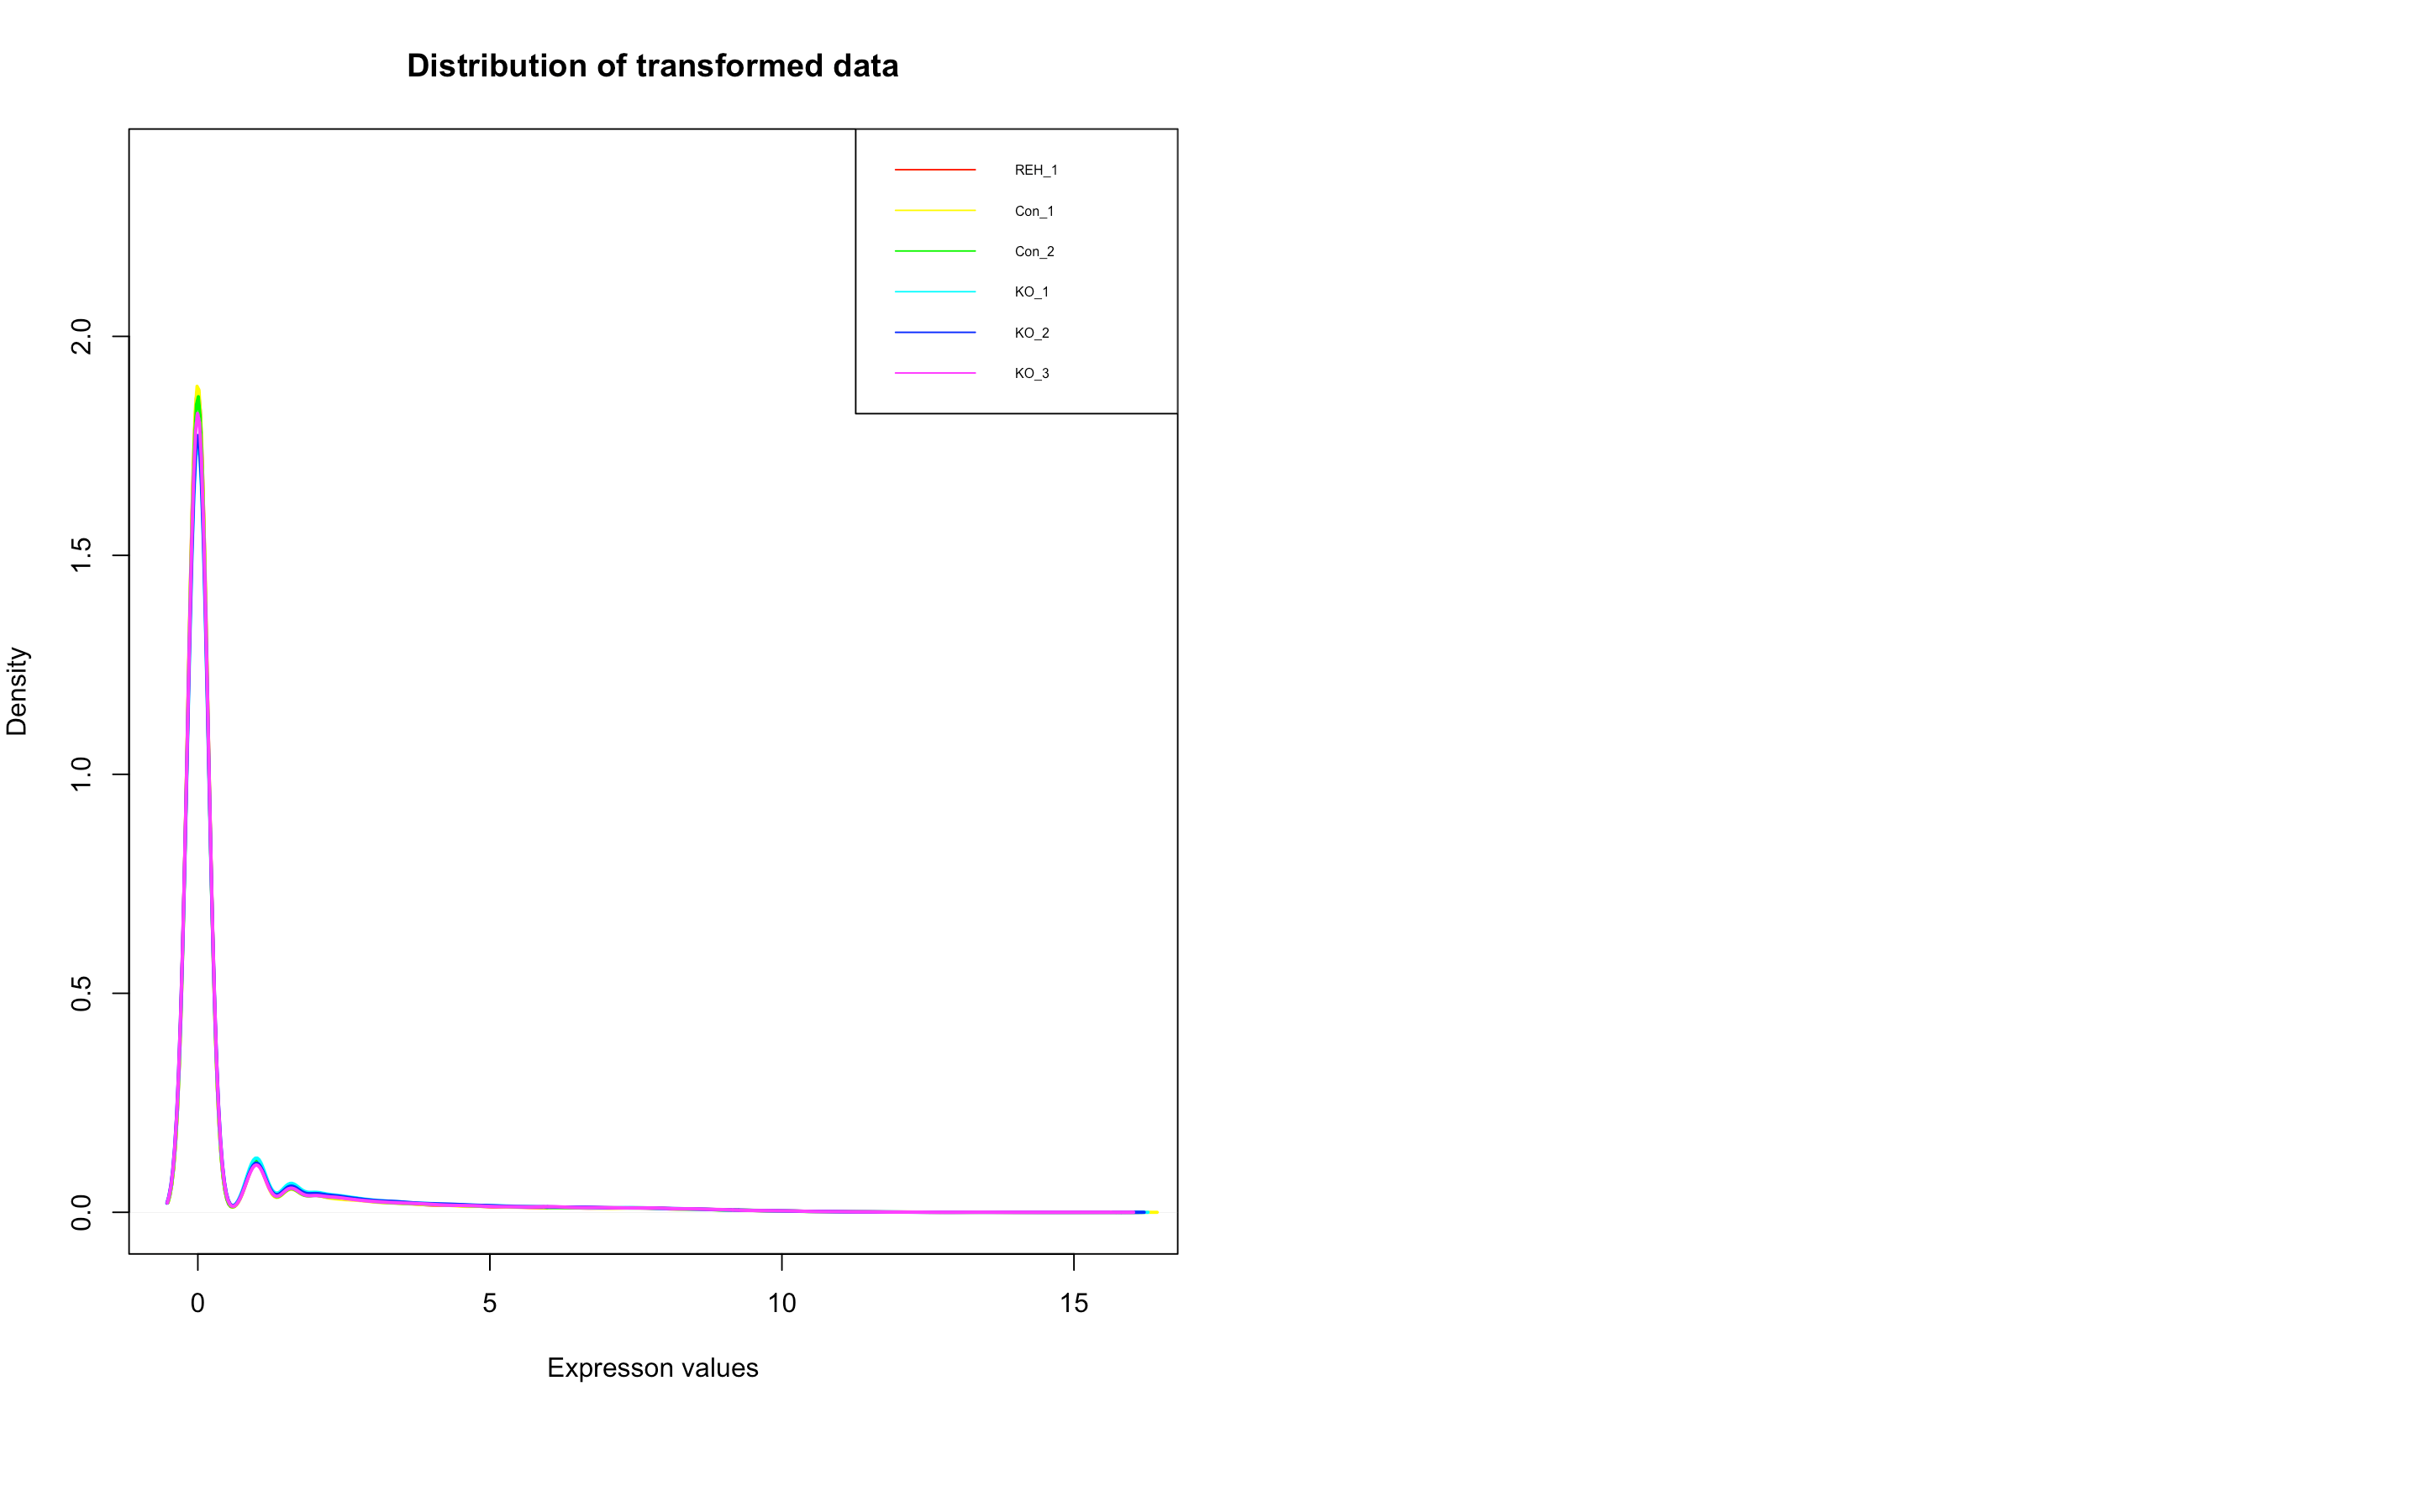
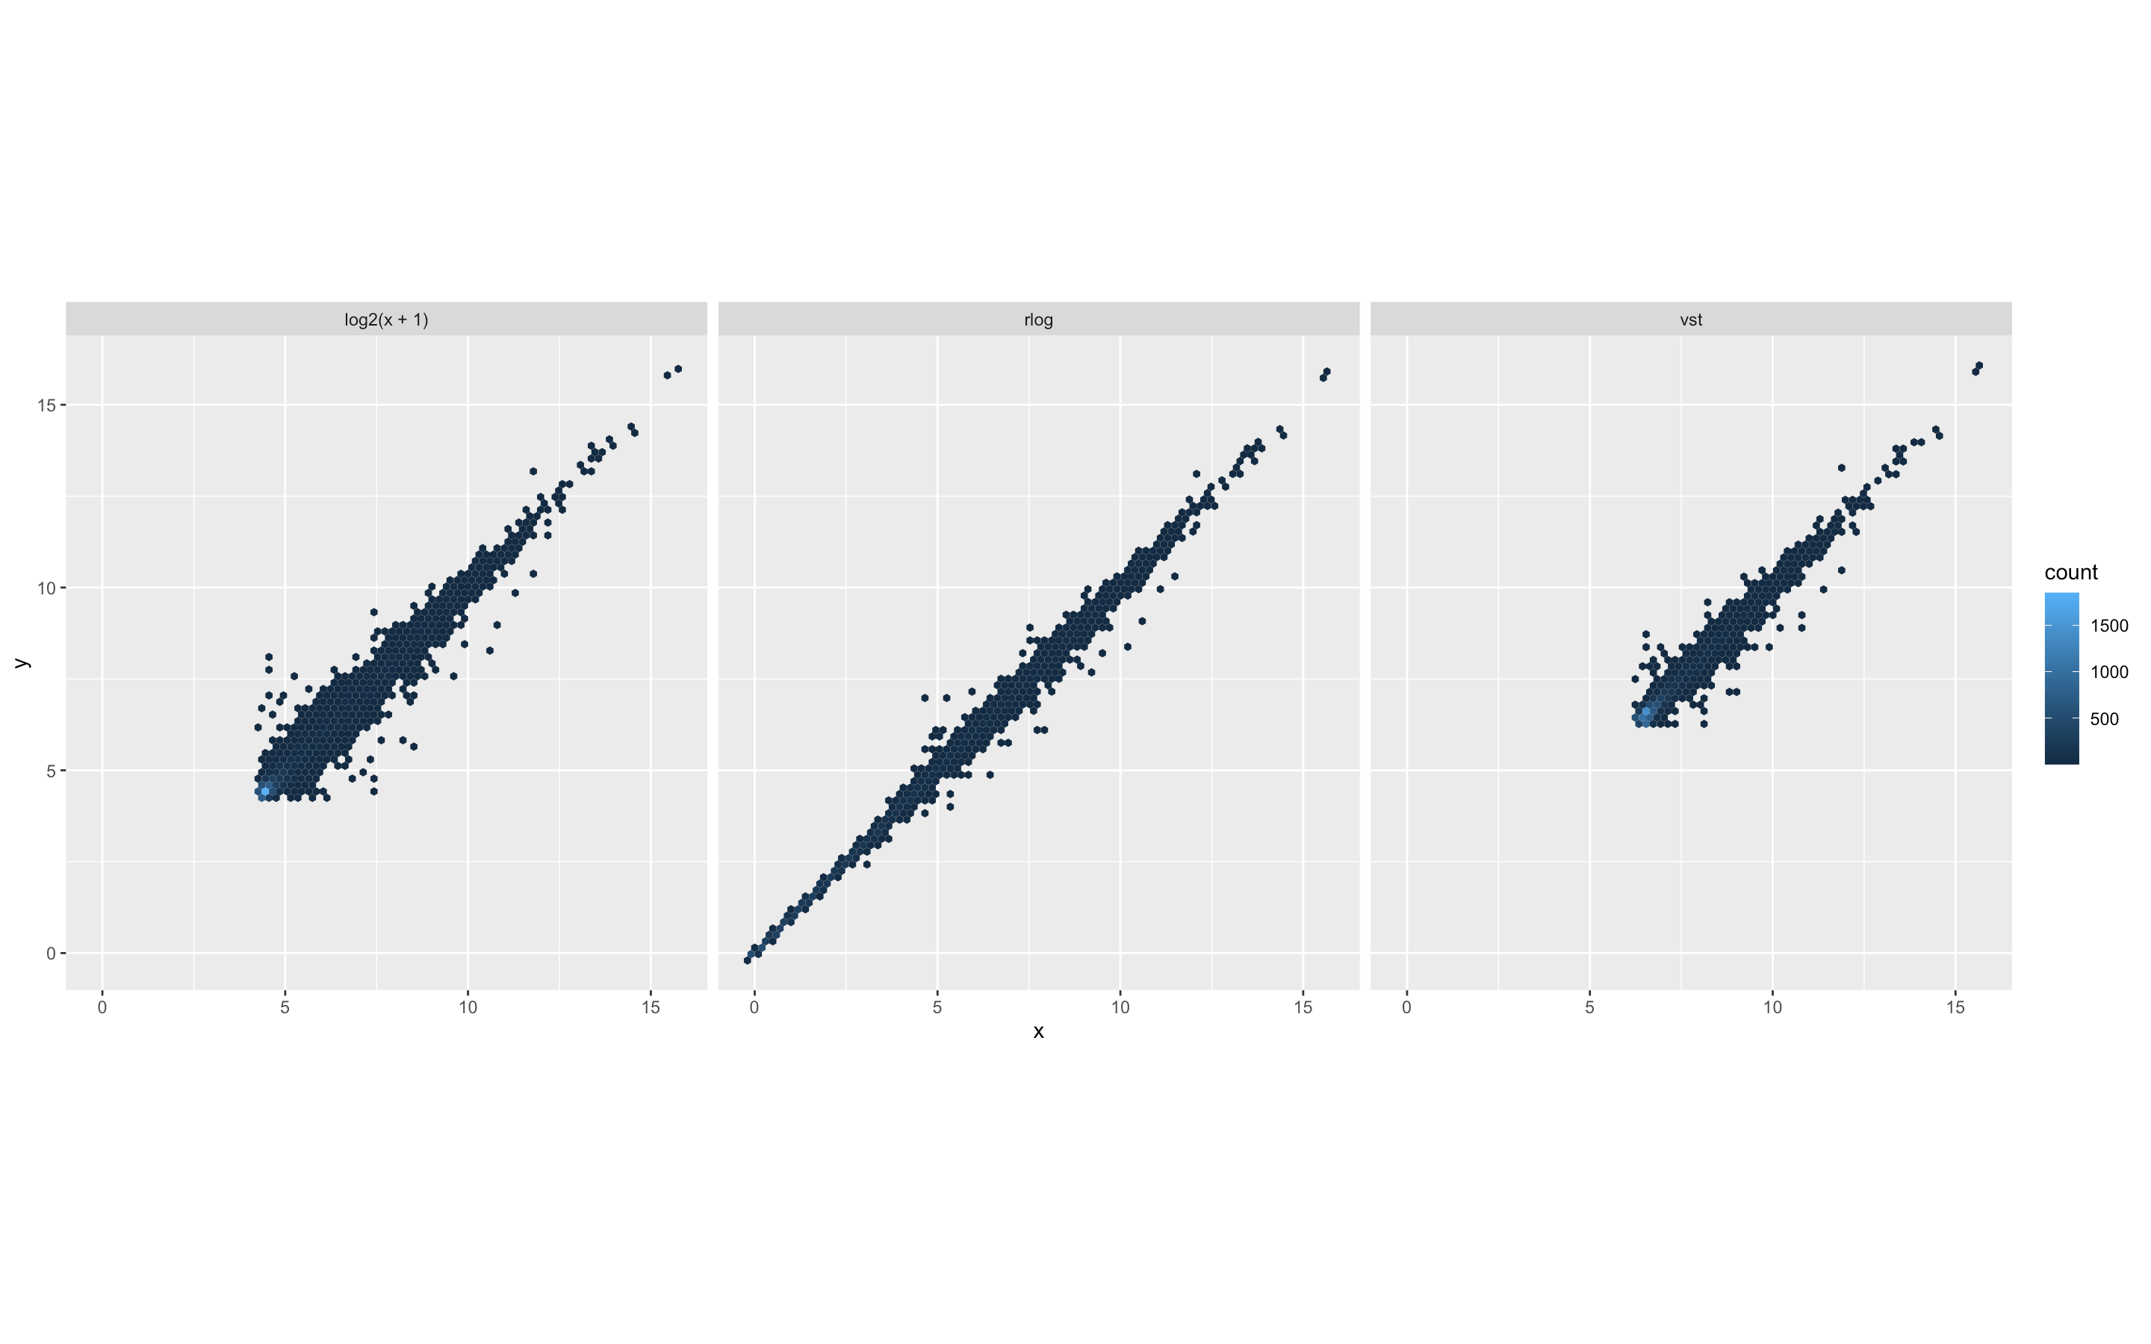
Data Transformation for DESeq2 on Rstudio

Slide 20
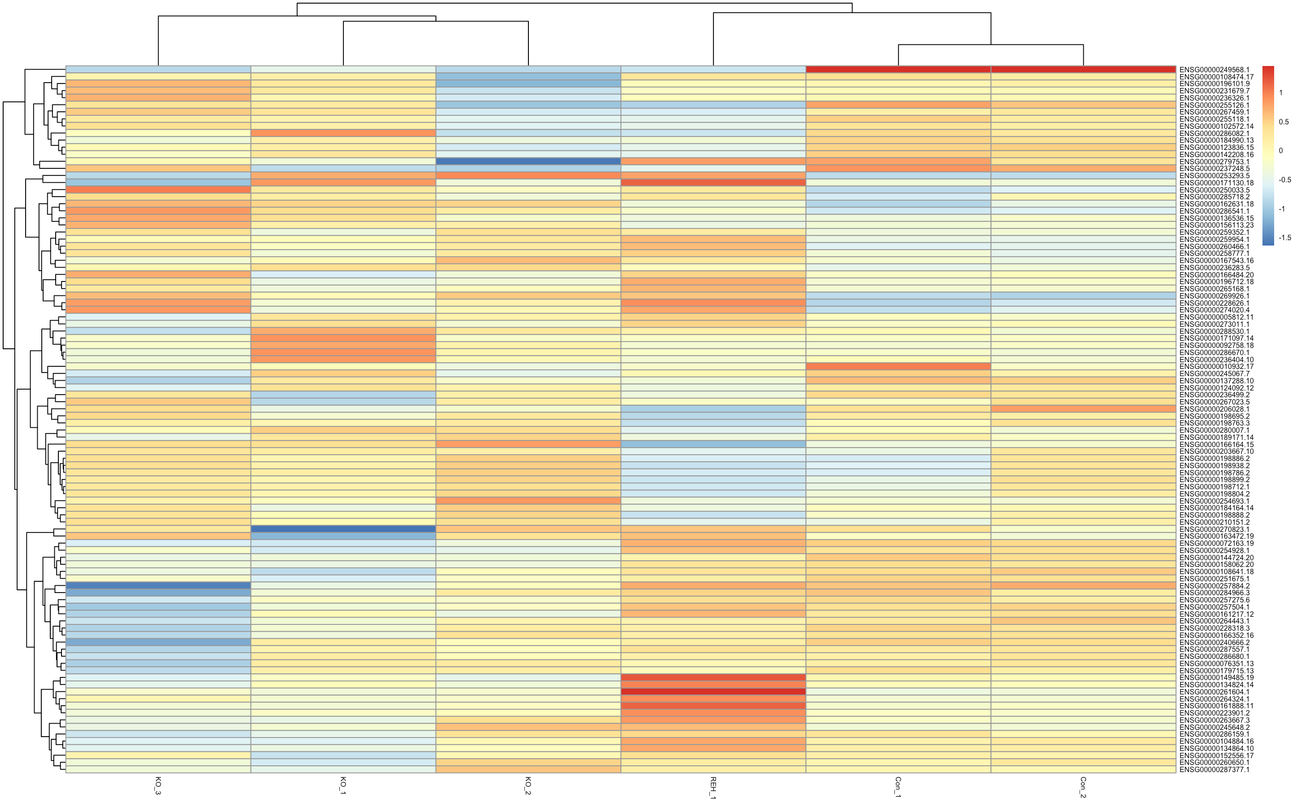
Heatmap on Rstudio

Slide 21
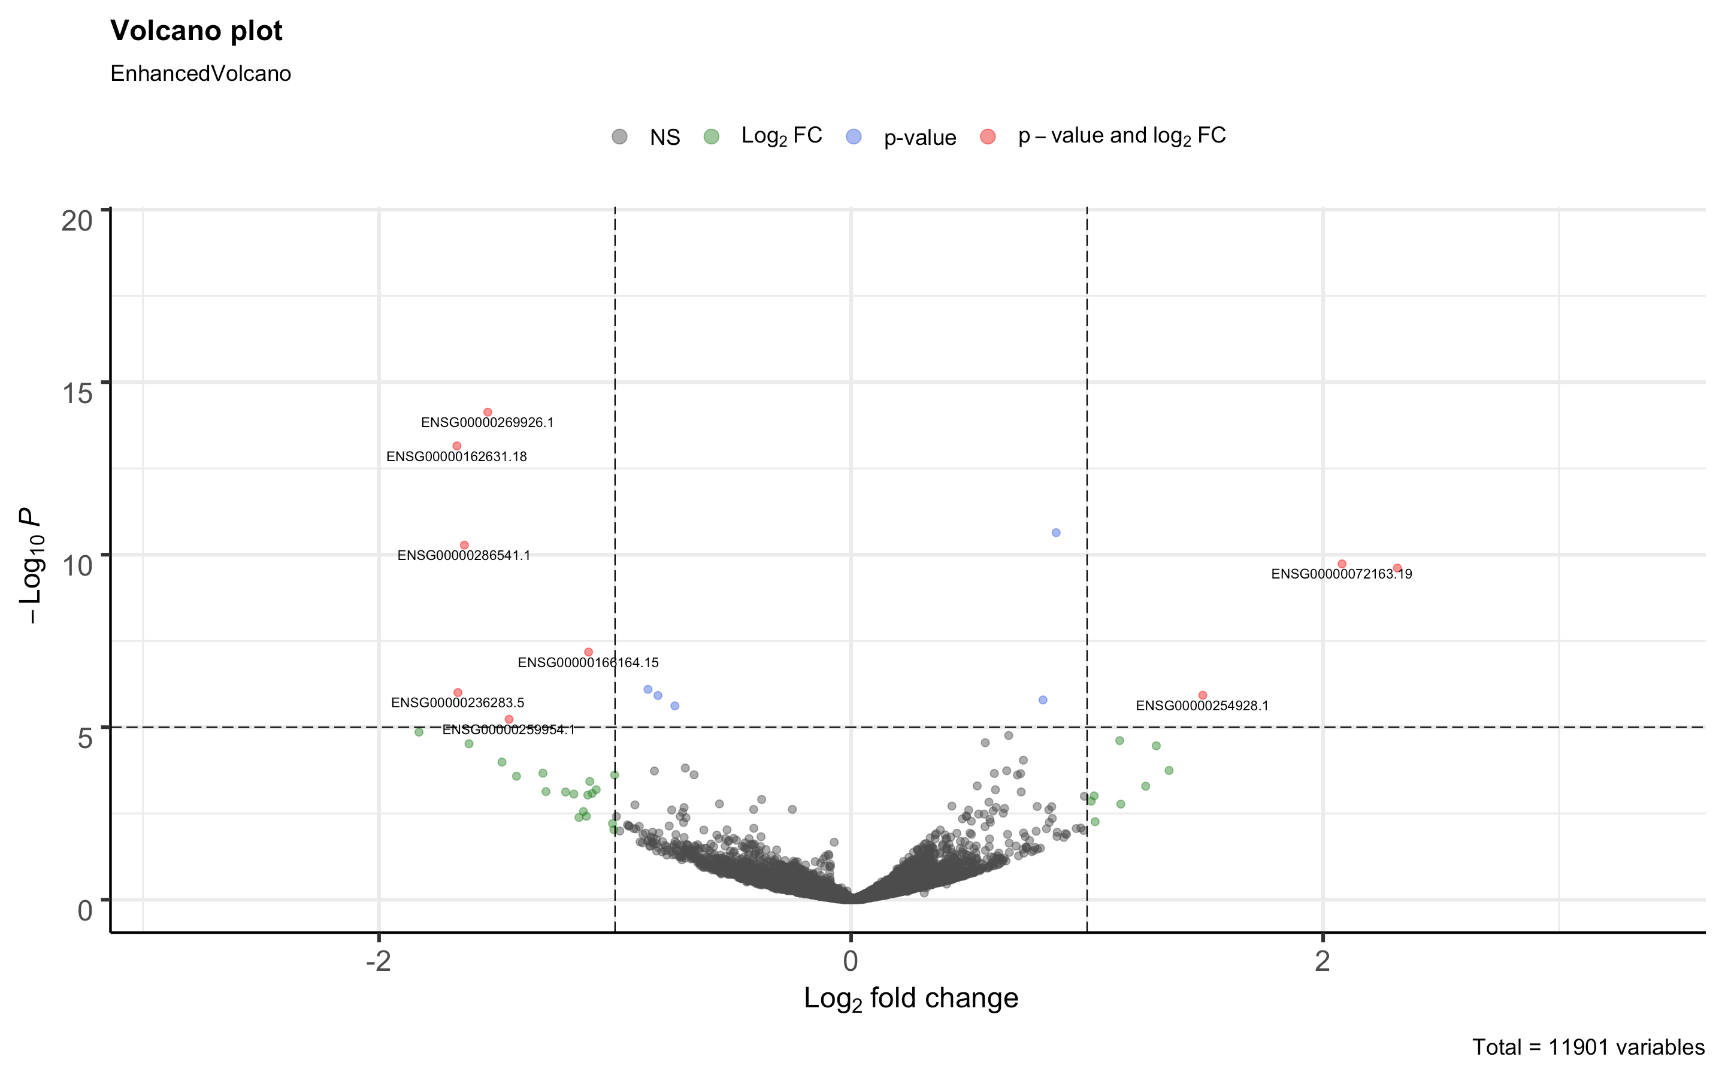
Volcano Plot on RStudio

Slide 22
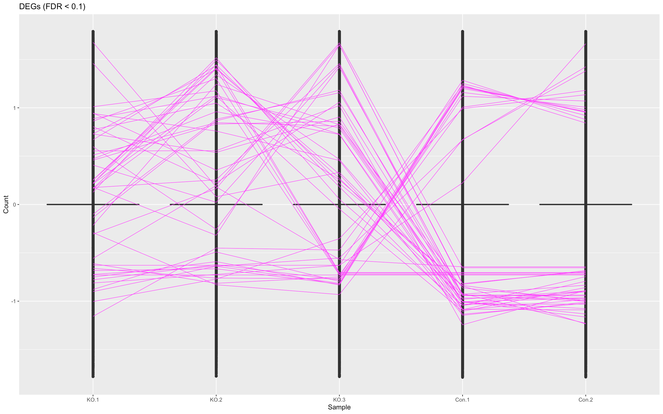
Boxplot using bigPint
Notes:
Where art thou box?

Slide 23
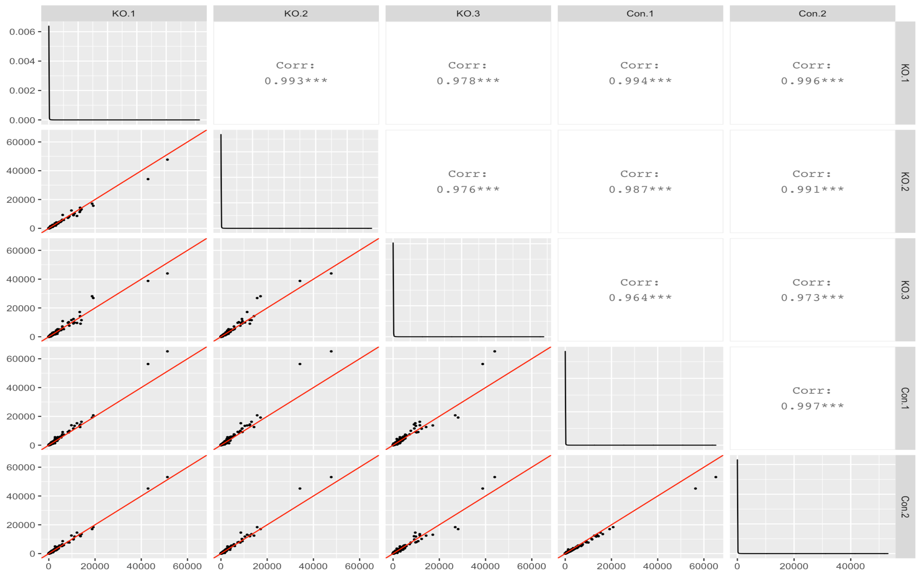
Scatter Matrix using bigPint
Notes:
Where art thou box?

Slide 24
Issues with bigPint
Boxplot does not have a box
Errors during clustering
Notes:
Where art thou box?

Slide 25
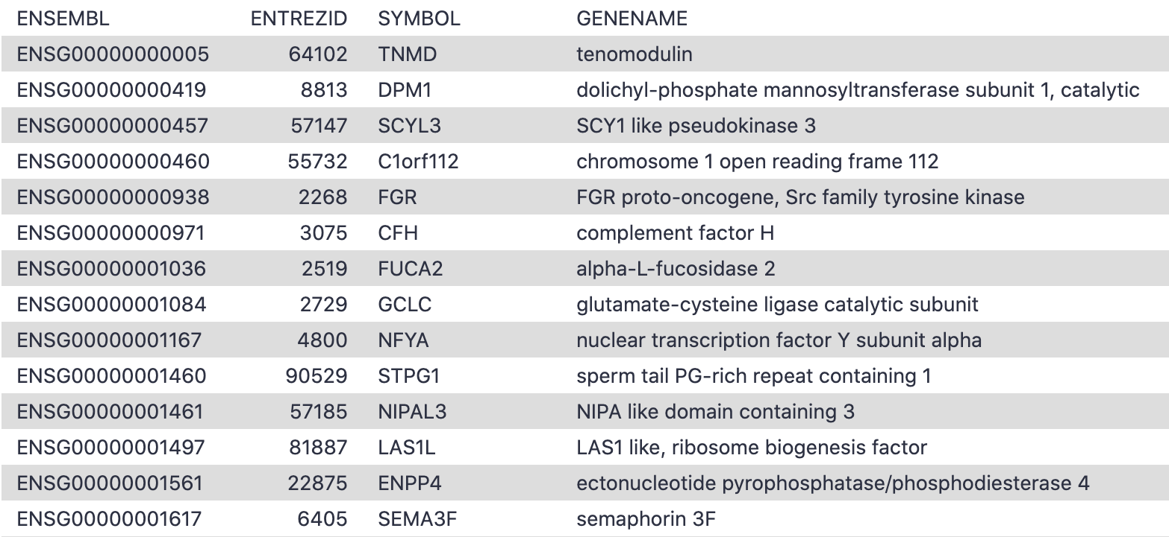
Annotate from ENSEMBL GeneID to Symbols

Slide 26
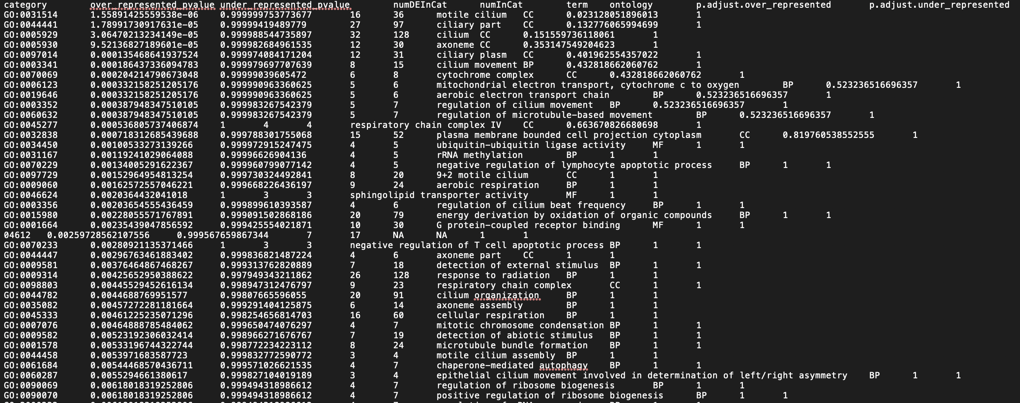
GOseq on Galaxy

Slide 27
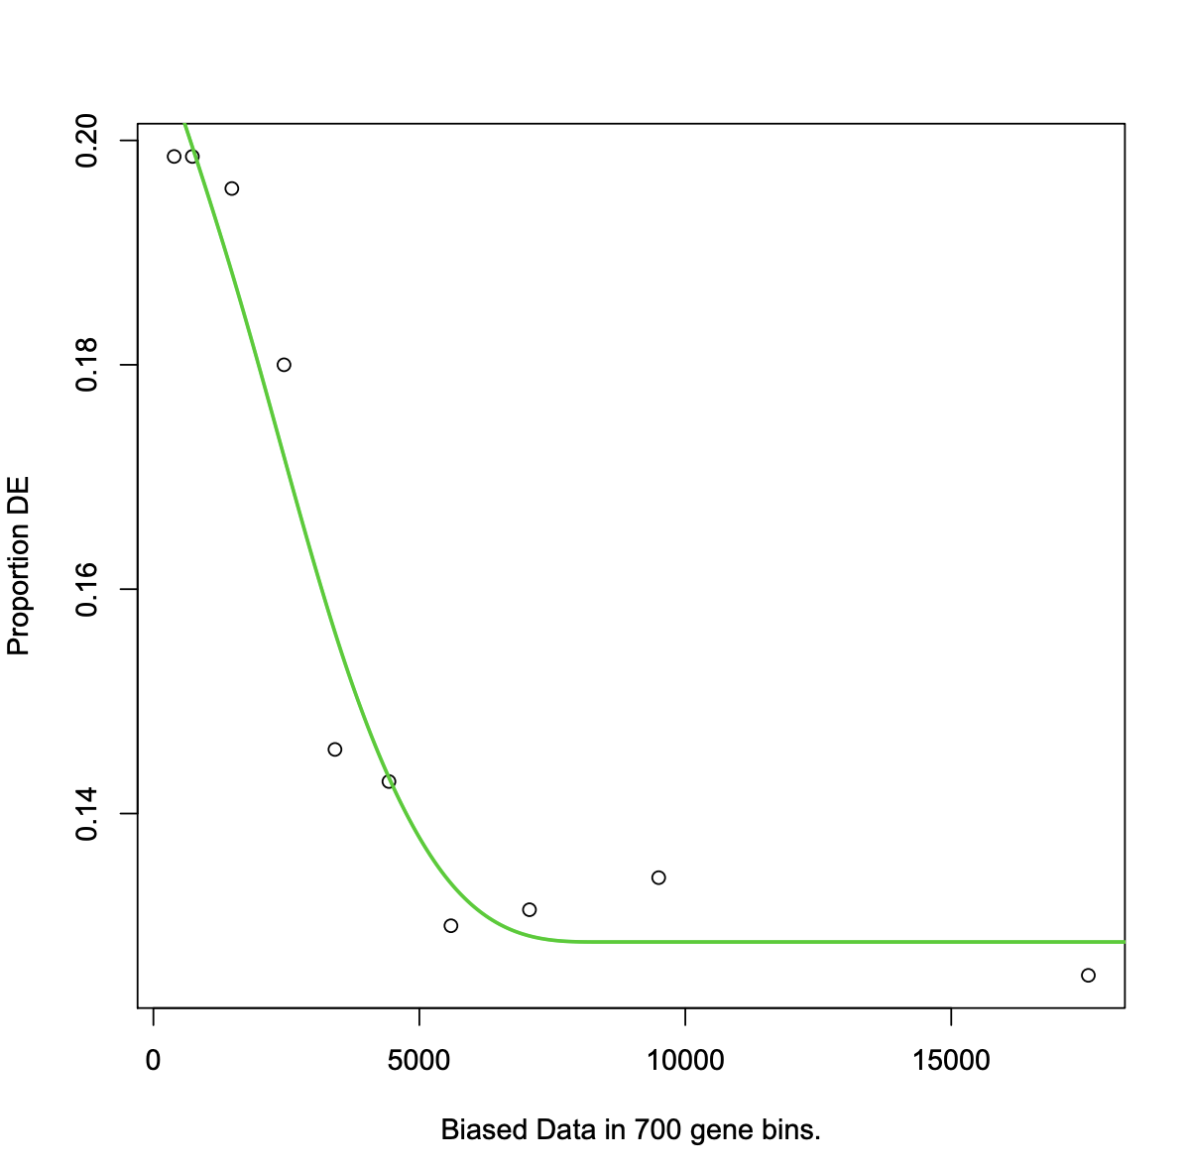
Length bias plot

Slide 28
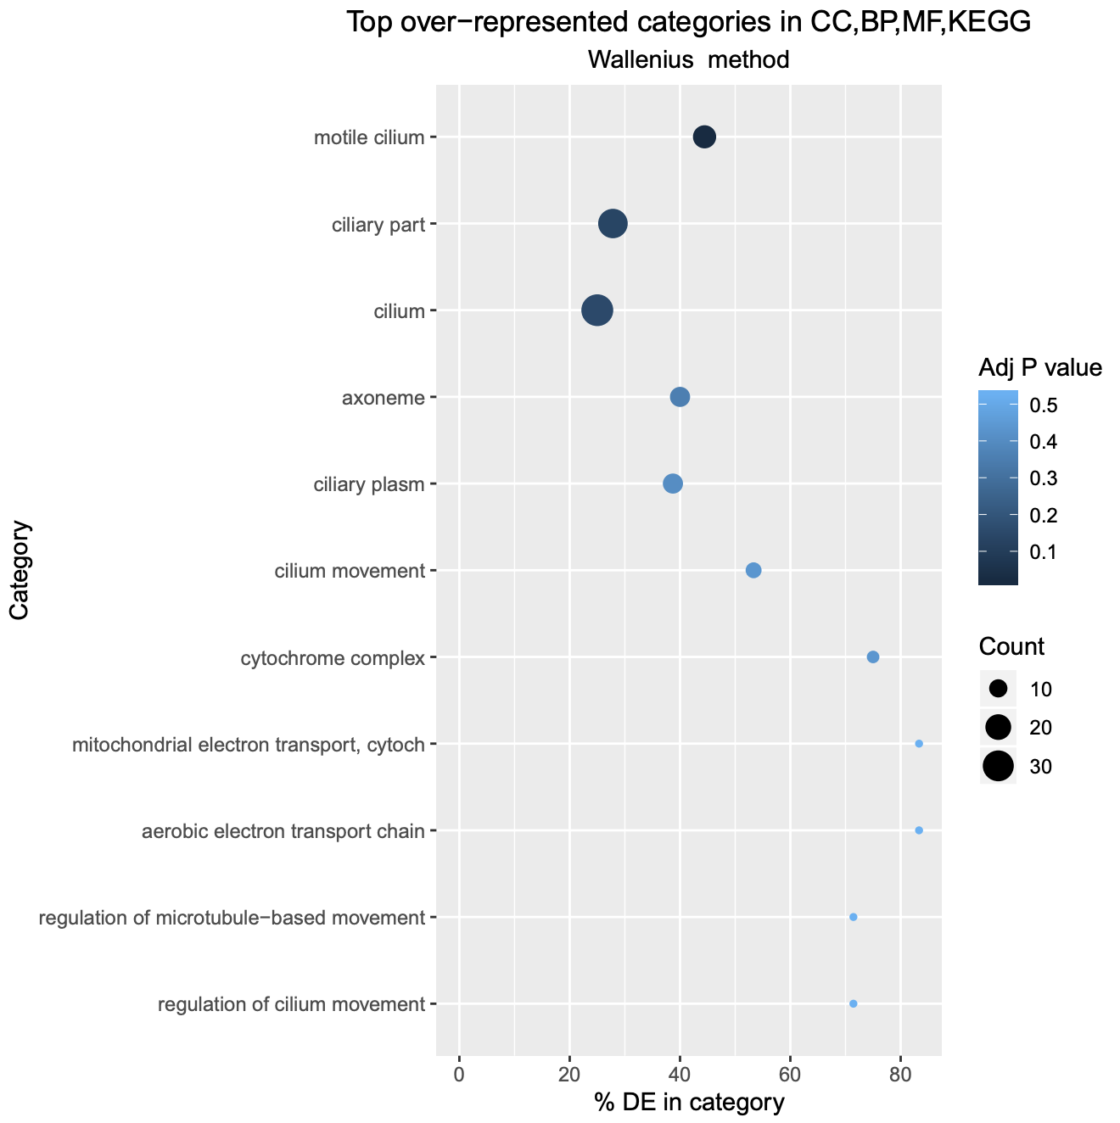
Top over-represented GO terms plot

Slide 29
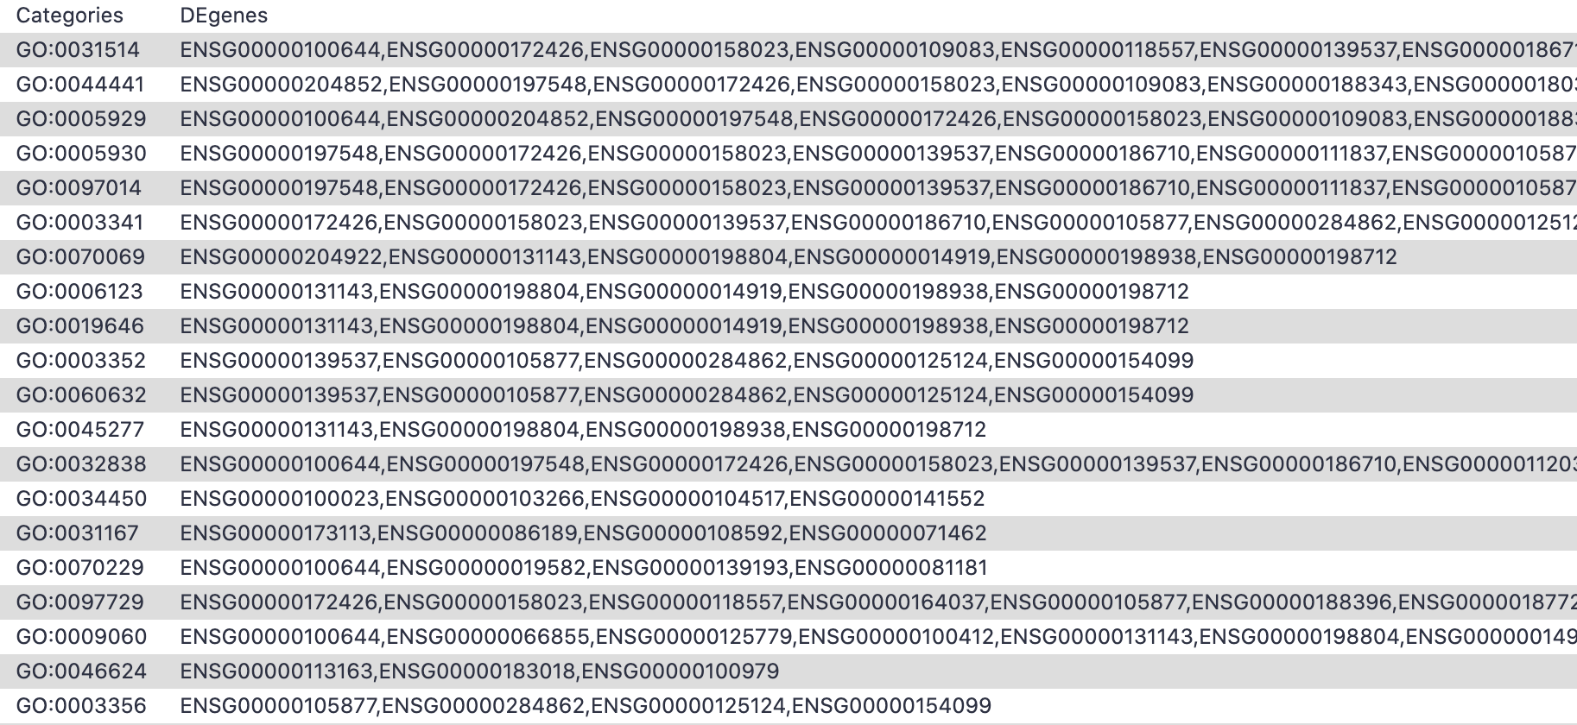
DE genes for categories (GO/KEGG terms)

Slide 30
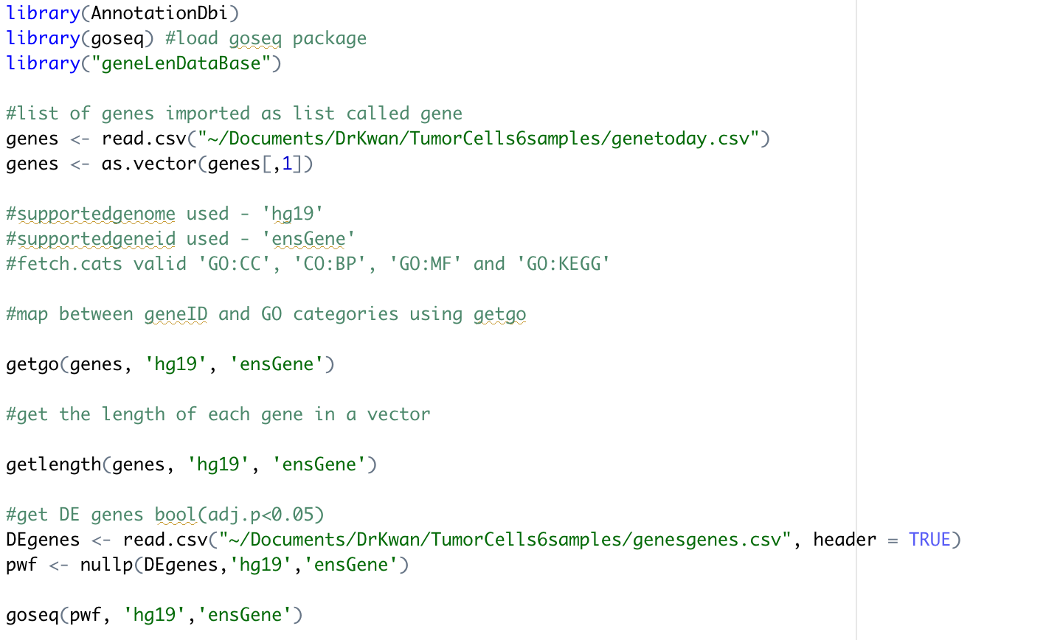
Attempted Code for GOSeq on RStudio

Slide 31
Input for GOSeq on RStudio
Probable cause of error is input file format
‘genes’ were extracted from the first column of DESeq2 results
Added a column to a DeSeq2 results that output 1 if adj.p <0.05 and 0 otherwise to show if the gene is differentially expressed
Created a list of the geneIDs corresponding to 1 as ‘DEgenes’

Slide 32
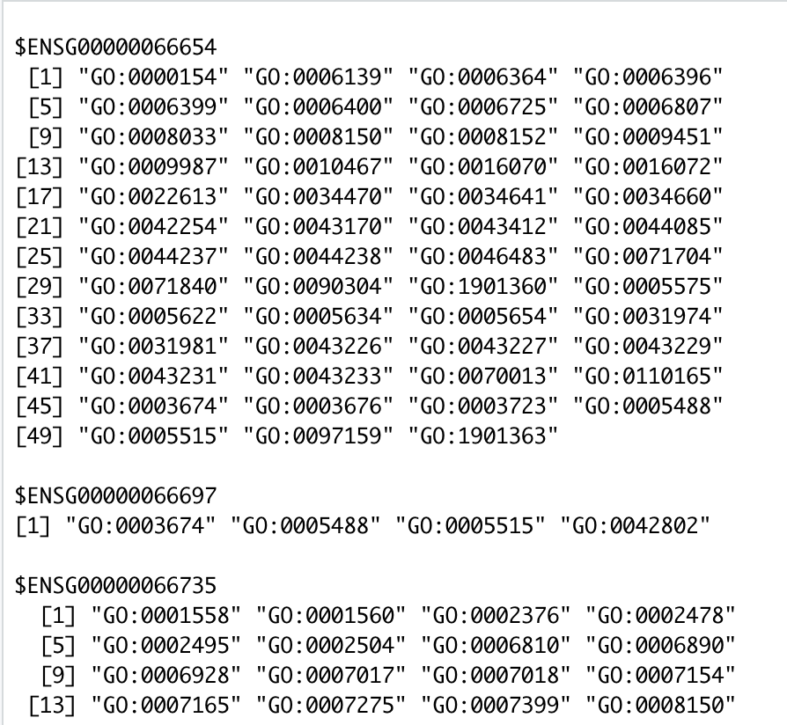
Output of getgo

Slide 33
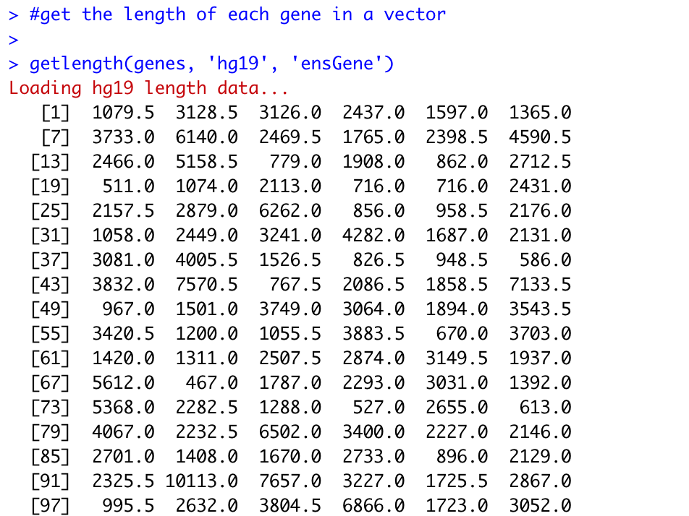
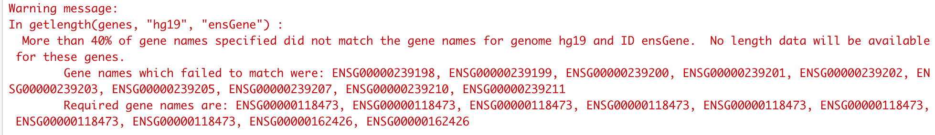
Output of getlength

Slide 34
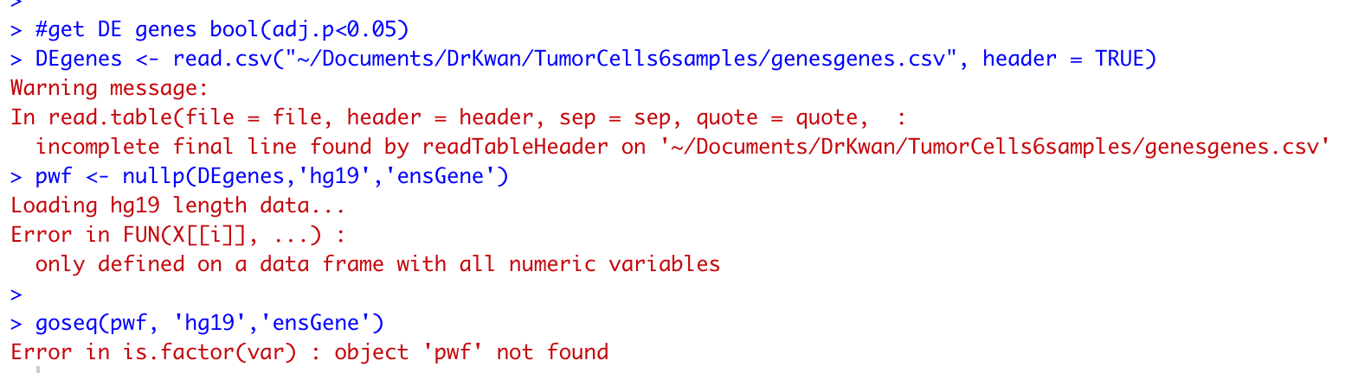
Error Message

Slide 35
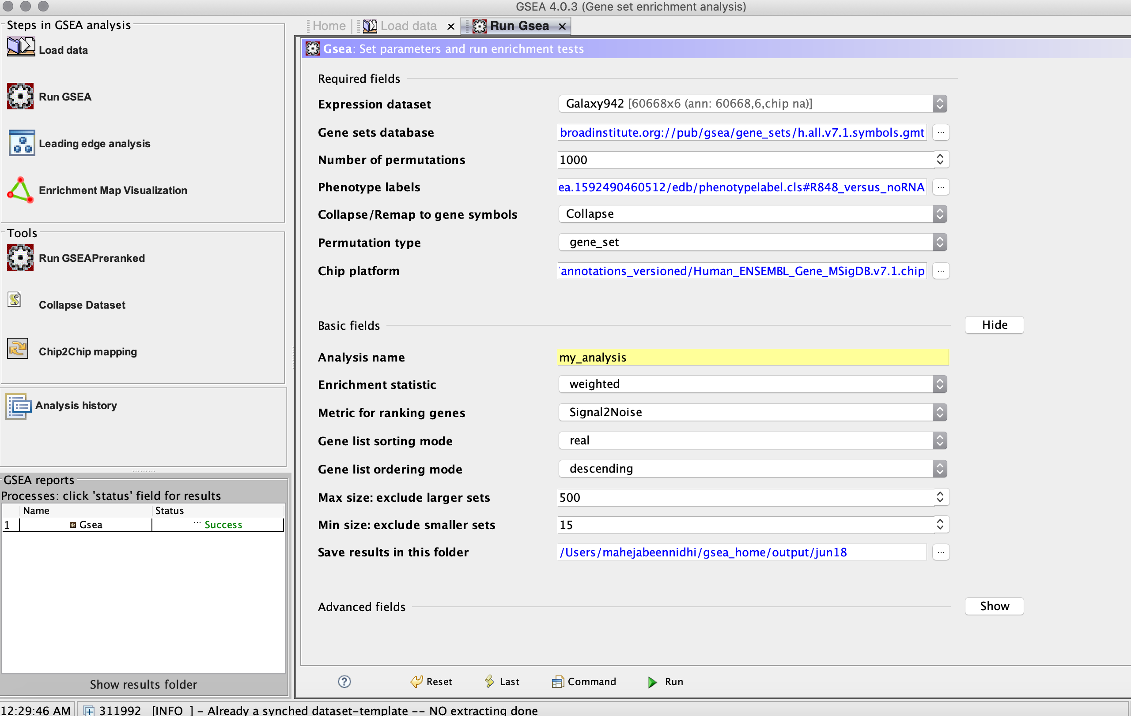
GSEA software from Broad Institute
Formatting of the input files are straightforward for GSEA as opposed to FGSEA and EGSEA tool on Galaxy

Slide 36
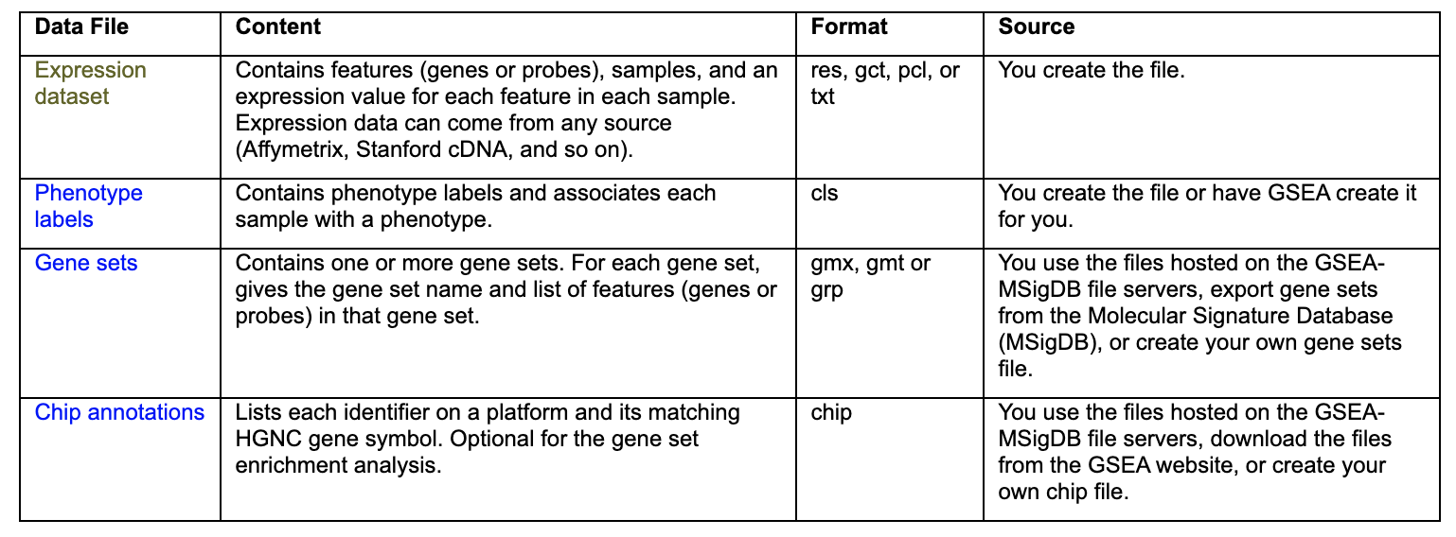
Input for GSEA
gct and cls files need to be made by self
Follows very specific format

Slide 37
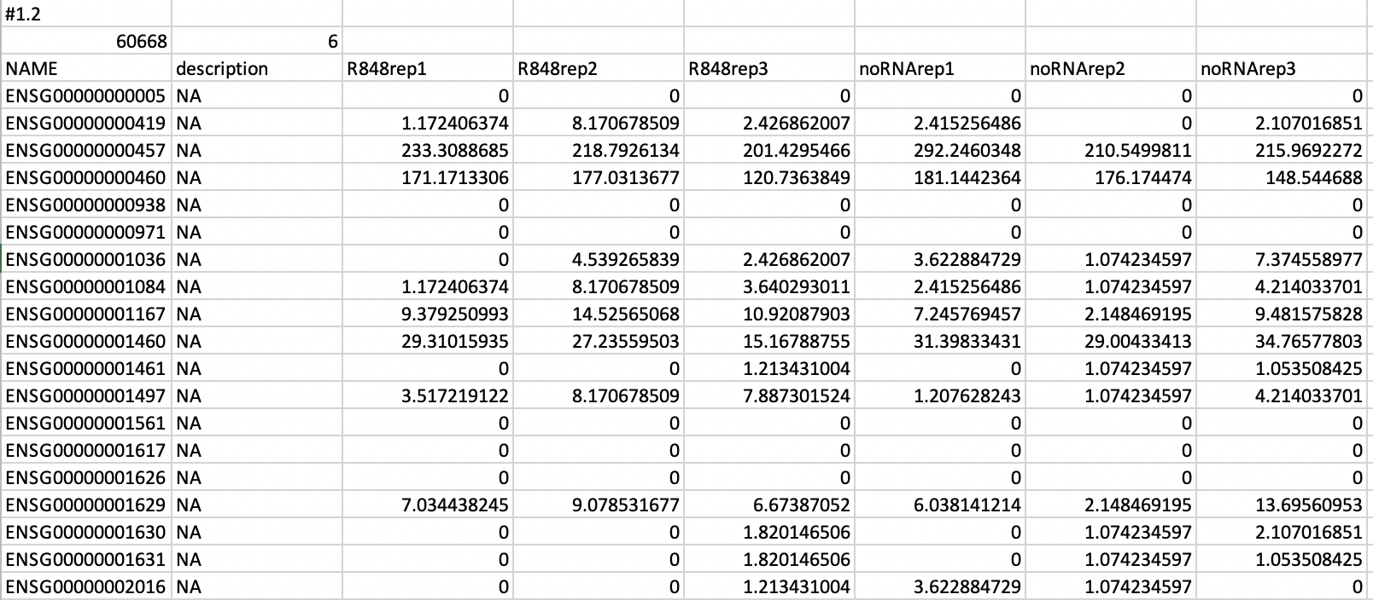
Expression dataset

Slide 38
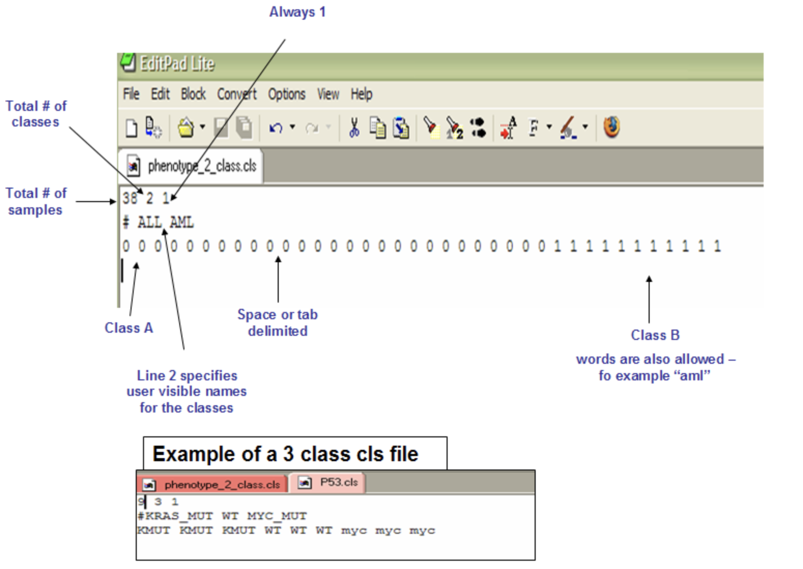
Phenotype labels

Slide 39
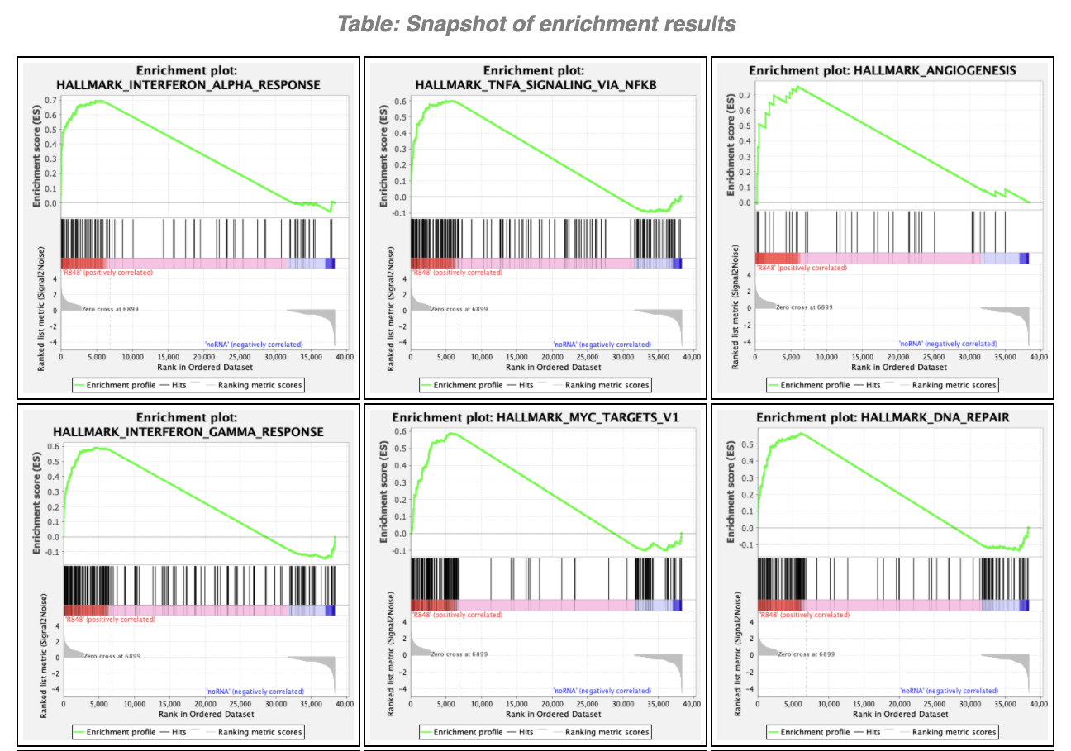
Enrichment plot: HALLMARK Gene Set (.gmt)

Slide 40
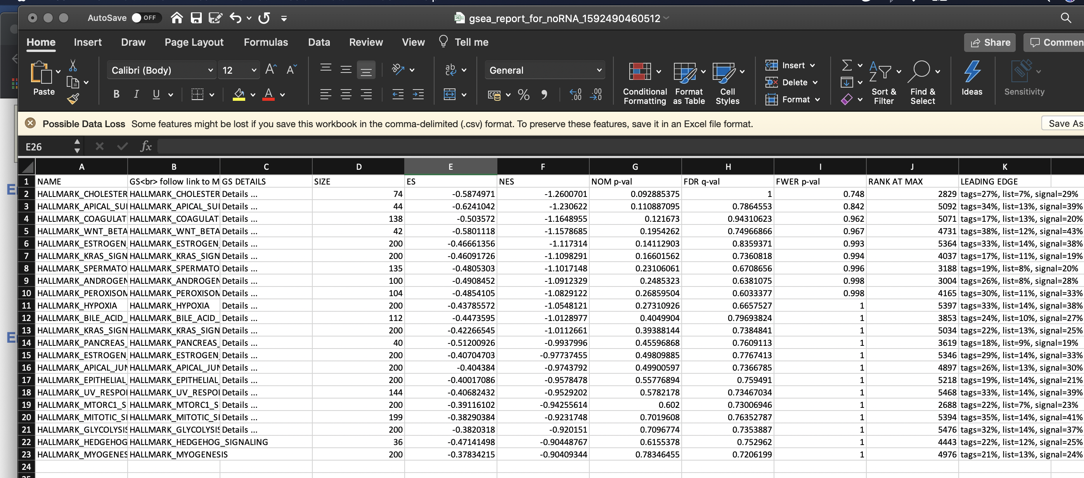
GSEA report example

Slide 41
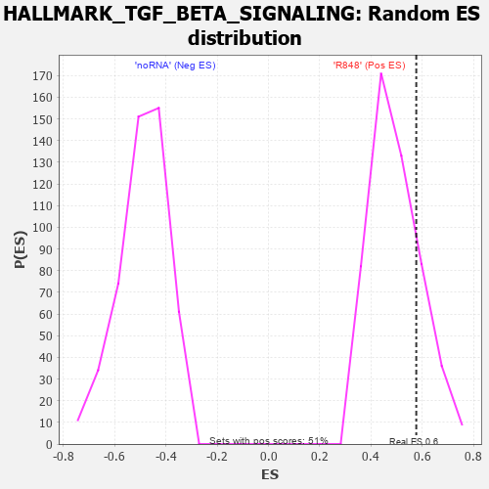
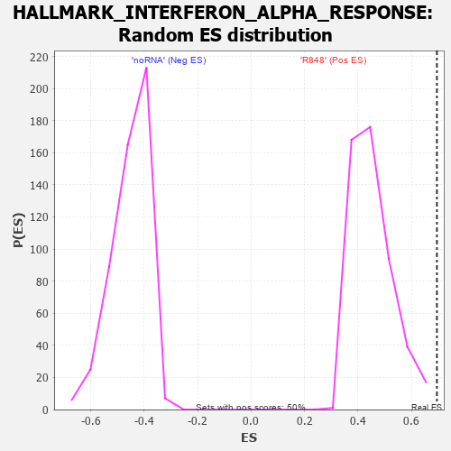
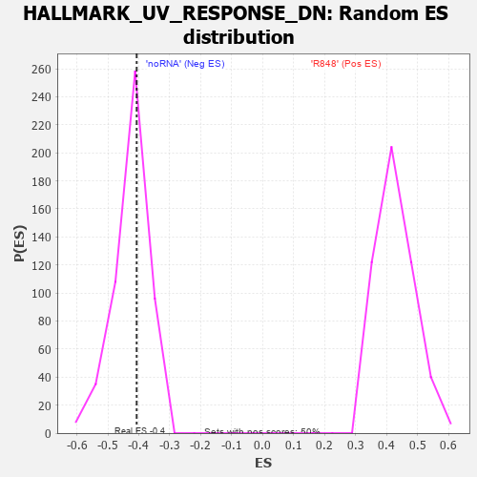
ES Distribution

Slide 42
Heatmap from GSEA

Slide 43
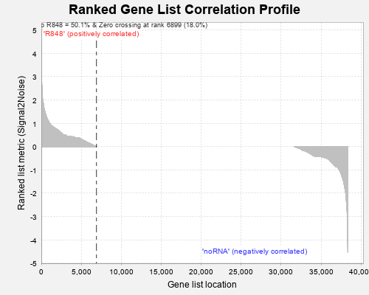
Ranked Gene List Correlation Profile

Slide 44
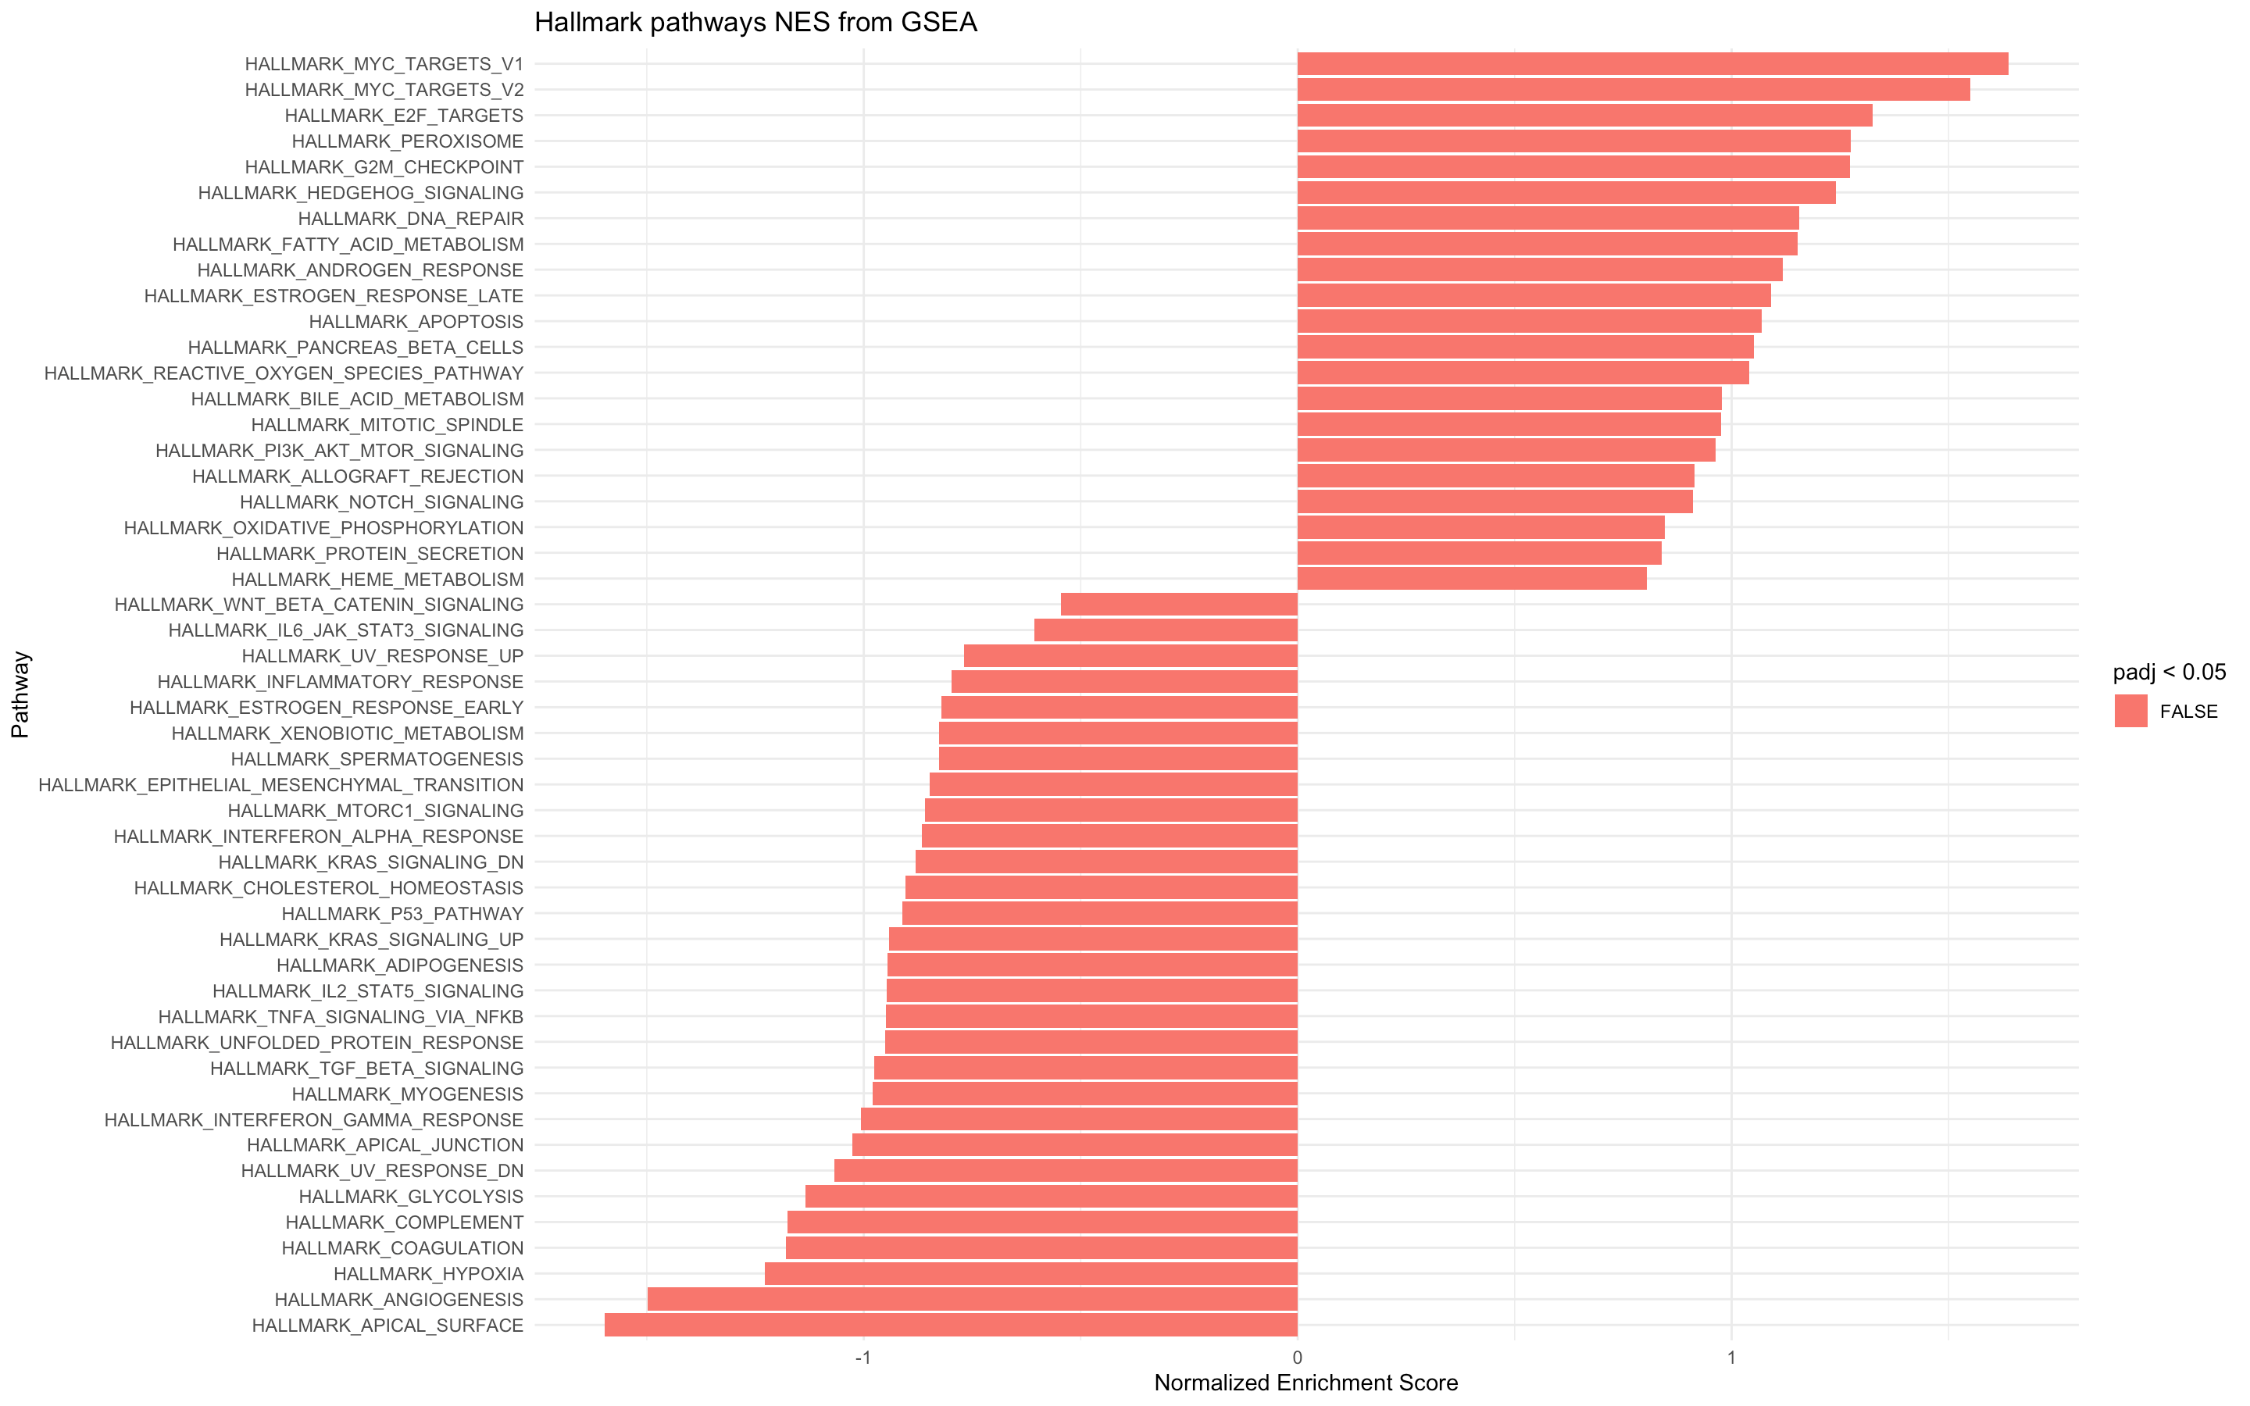
FGSEA on RStudio
Only returns one pathways to be TRUE when padj<0.80

Slide 45

FGSEA on RStudio

Slide 46

EGSEA on Rstudio (Voom Object)

Slide 47

Error loading EGSEA library

Slide 48
PANTHER Classification System Pie Charts
Molecular Function
Biological Process
Cellular Component
Protein Class
Pathway

Slide 49





Slide 50
In Progress
Troubleshooting GOSeq on R Studio
GSEA on Rstudio
Clustering with bigPint

